Slide 1
Value of Information Analysis in Spatial Models
Jo Eidsvik
Jo.eidsvik@ntnu.no

Slide 2
Plan for course
Time | Topic
Monday | Introduction and motivating examples
 | Elementary decision analysis and the value of information
Tuesday | Multivariate statistical modeling, dependence, graphs
 | Value of information analysis for dependent models
Wednesday | Spatial statistics, spatial design of experiments
 | Value of information analysis in spatial decision situations
Thursday | Examples of value of information analysis in Earth sciences
 | Computational aspects
Friday | Sequential decisions and sequential information gathering
 | Examples from mining and oceanography
Every day: Small exercise half-way, and computer project at the end.

Slide 3
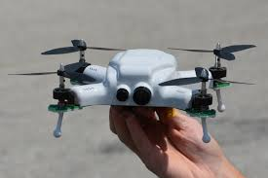
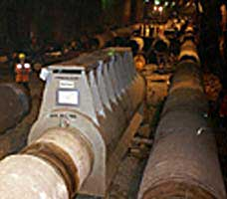
Other applications
Robotics - where should drone (UAV) or submarine (AUV) go to collect valuable data?
Automatic maintenance – how to allocation sensors to ‘best’ monitor state of system?
Adaptive testing – which questions to ask for optimal recommendation system?
Internet of things – which sensors should be active now?

Slide 4
Which data are valuable?
Five Vs of big data:
Volume
Variety
Velocity
Veracity
Value
We must acquire and process the data that has value!
There is often a clear question that one aims to answer, and data should help us.

Slide 5
Value of information (VOI)
In many applications we consider purchasing more data before making difficult decisions under uncertainty.
VOI is useful for quantifying the value of the data, before it is acquired and processed.
ECONOMIC
This pyramid of conditions - VOI is different from other information criteria (entropy, variance, prediction error, etc.)

Slide 6
Formula for VOI
The analysis is usually done for static decisions and static tests:
We make the one-time decisions here and now.
We can only collect the data here and now.
Sequential decisions or sequential tests can give benefits.

Slide 7
Sequential decision (prior value)
.
Solution is a discrete optimization method called dynamic programming:
Go through all possible decision paths, moving forward.
Find the optimal values winding backwards in the tree of paths .
This is costly for large systems, and several approximations exists.
Suboptimal strategies, using heuristics, are often used in practice, with success.

Slide 8
Sequential decisions (VOI)
.
Must now use dynamic programming for different data outcomes.
VOI is difference between posterior and prior value.

Slide 9
Information gathering
.
 | Perfect | Imperfect
Total | Exact observations are gathered for all variables. This is rare, occurring when there is extensive coverage and highly accurate data gathering. | Noisy observations are gathered for all variables. This is common in situations with remote sensors with extensive coverage, e.g. seismic, radar, satellite data.
Partial | Exact observations are gathered at some variables. This might occur, for instance, when there is careful analysis of some samples, or sensors at some locations. | Noisy observations are gathered at some variables. Examples include noisy sensors for local monitoring, testing along a survey line, etc.
Could also have sequential (adaptive) information gathering.

Slide 10
Sequential information gathering
.
Decision maker has the opportunity of dynamic testing, where one can stop testing, or continue testing, depending on the currently available data. The sequential order of tests and the number of tests also depend on the data.
Continue testing.
Stop testing.
Continue testing.
Solution is again dynamic programming.
Stop testing.

Slide 11
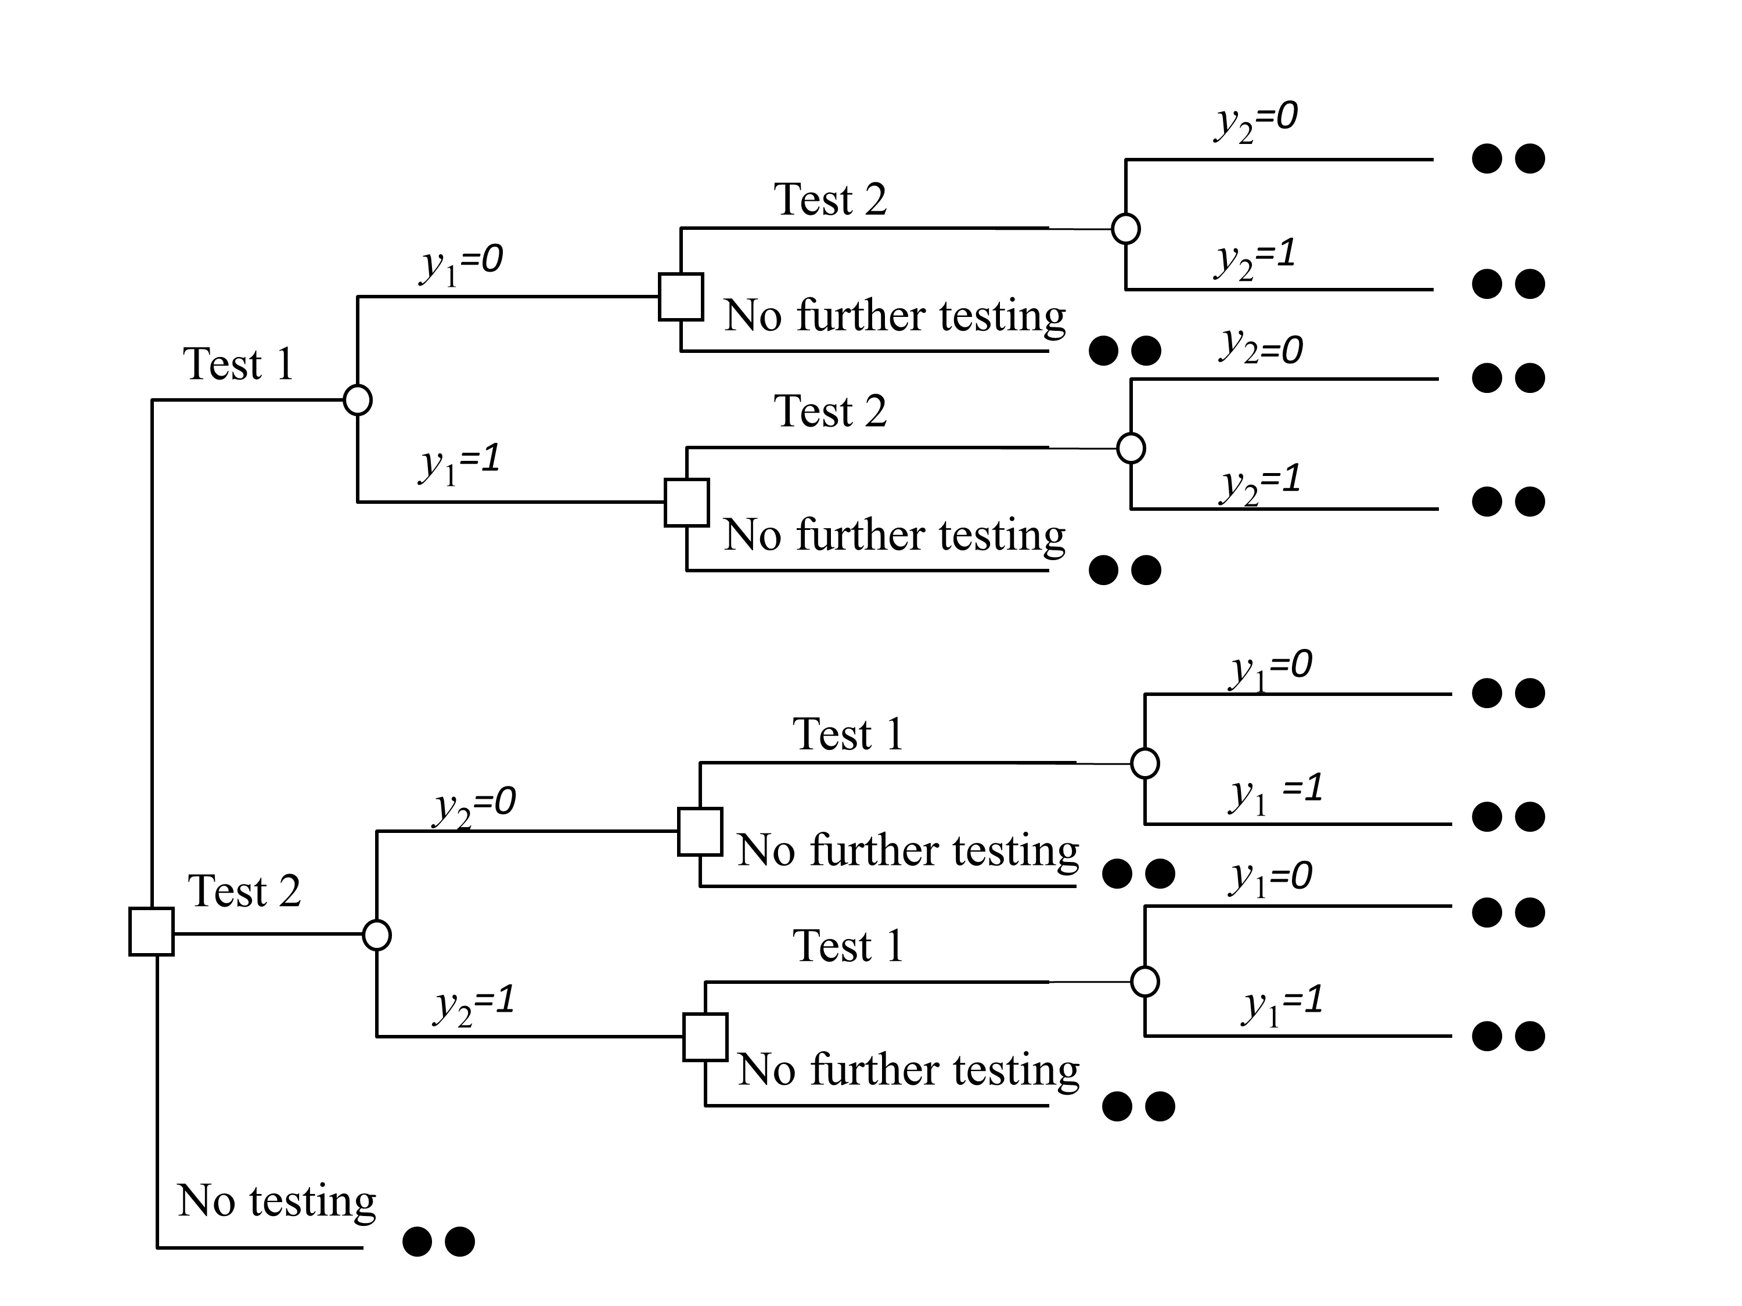
Sequential testing– bivariate illustration
.

Slide 12
Sequential information (bivariate data)
.
Value with no more testing (after first test):
Criterion for continued testing:
Continue testing when the additional expected value of more testing excceds the price.

Slide 13
Sequential decisions and testing
Of course, one can have both sequential decisions and sequential data gathering!
Even more complex to evaluate and interpret, but it also gives opportunities.
Not considered here.

Slide 14
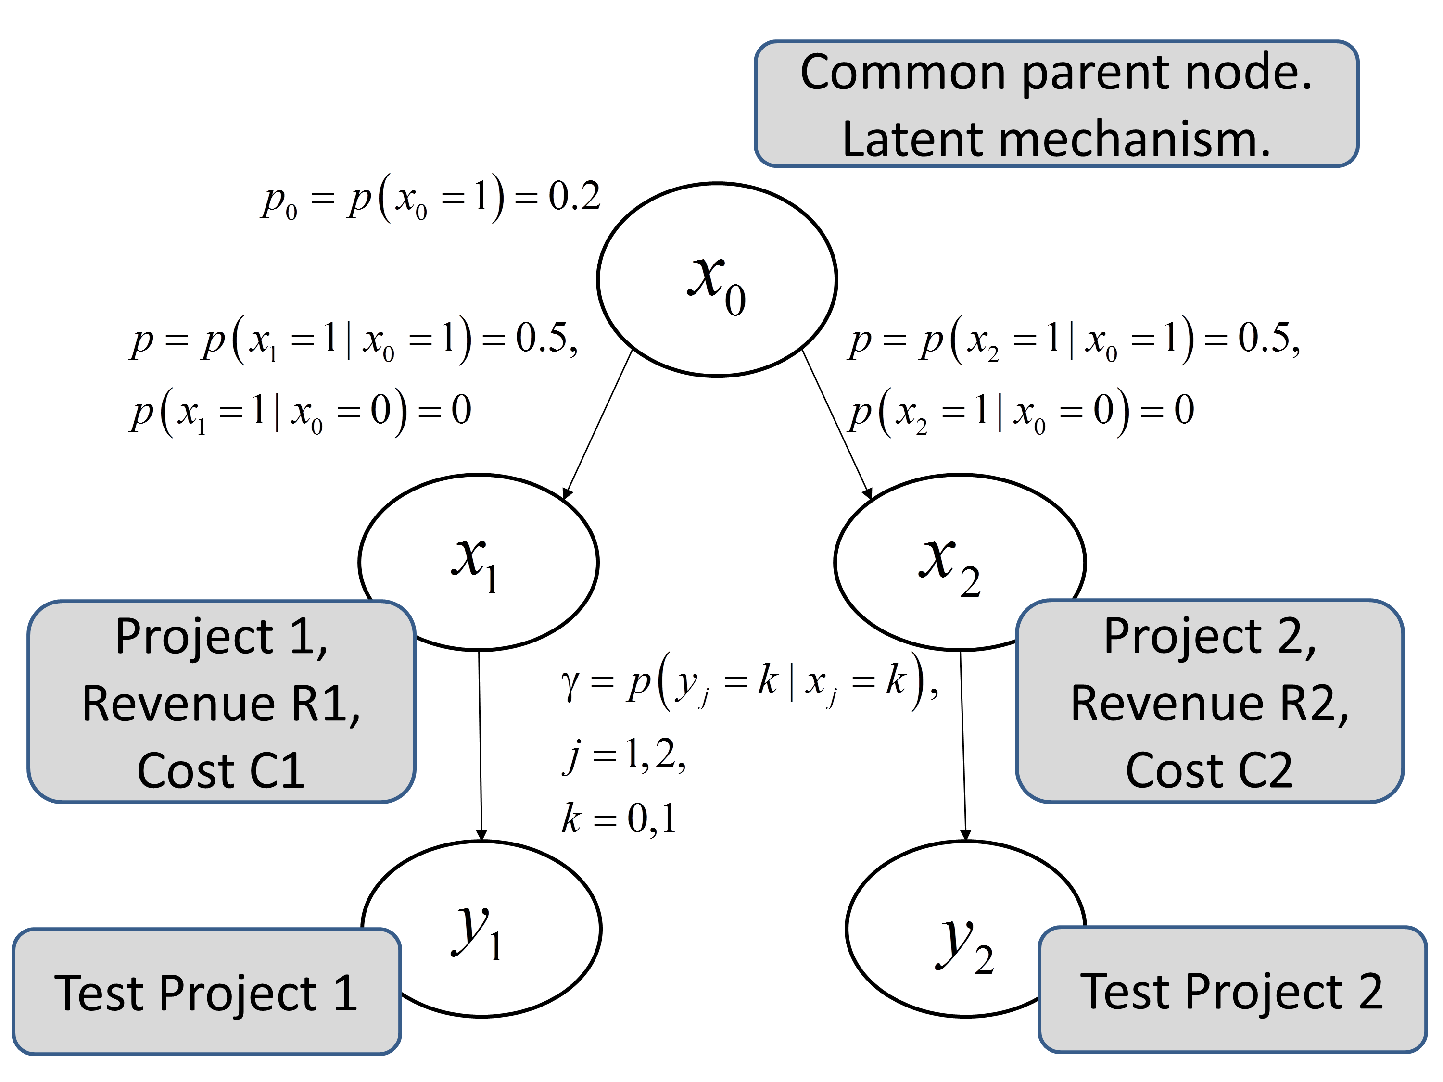
Bivariate projects example
.

Slide 15
Bivariate projects example
.
Need to frame the decision situation:
Can one freely select (profitable) projects, or must both be selected? Free selection.
Does value decouple? No coupling.
Can one do sequential selection? Non-sequential.
Need to study information gathering options:
Imperfect test, or perfect test? Study both.
Can one test both prospects, or only one (total or partial)? Study both.
Can one perform sequential testing? Compare non-sequential / sequential testing.
Focus on information gathering.

Slide 16
Bivariate projects example - static
.
Total imperfect information,
static
With sequential testing, we do one test, and can continue with second, if it is worthwhile to do so.

Slide 17
Sequential testing– Bivariate projects
.
Sequential has the opportunity to test two.
Static, stops after first.

Slide 18
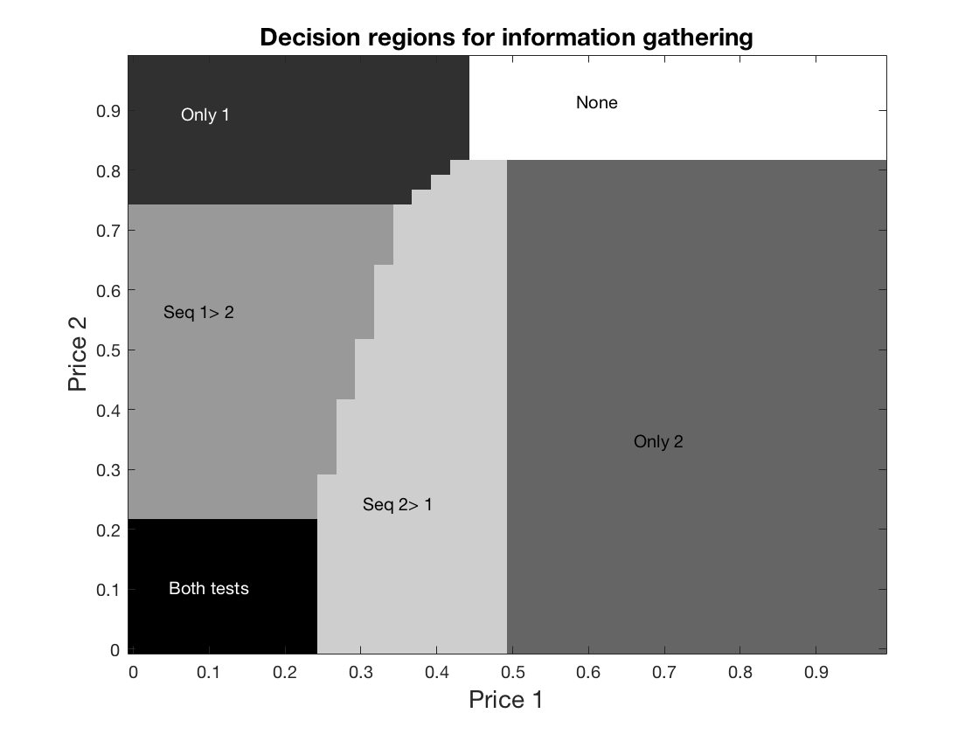
Decision regions for project testing
Sequential testing is better than static (only 1, or 2 tests), for a large set of price levels.

Slide 19
Decision regions for other correlations
.
Exercise:
Discuss what the decision regions would look like for almost no correlation (but same marginal probabilities).
Discuss what the decision regions would look like for very high correlation (but still same marginal probabilities).

Slide 20
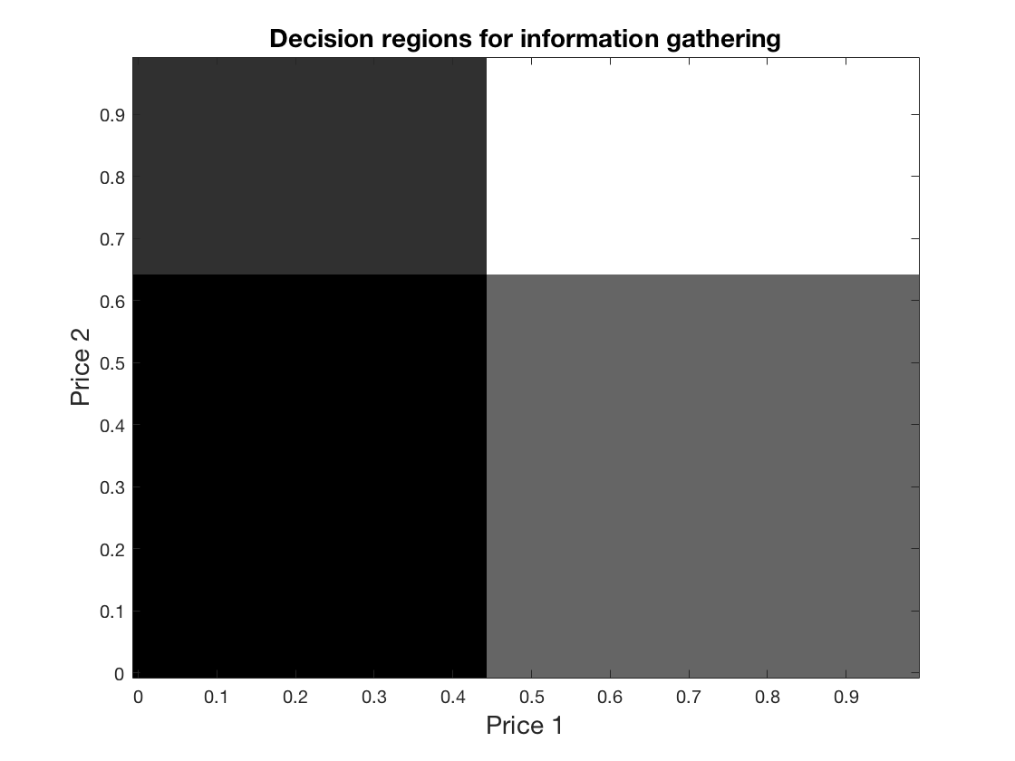
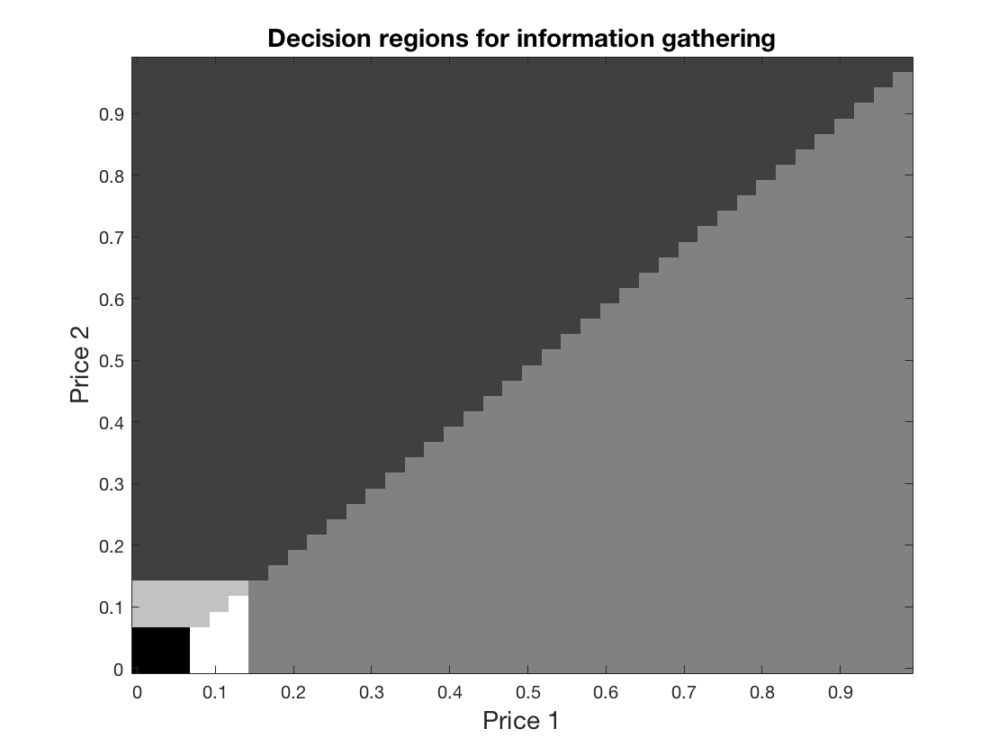
Decision regions for low/high corr
.
High dependence: One only is usually preferred, because partial test extremely informative. Sequential not needed.
Low dependence: VOI is additive, no value in sequential testing.

Slide 21
Myopic strategy for information
.
Myopic (near-sighted) is a common strategy for sequential problems.
It considers only one-stage at a time, not looking into the ‘future’.
Find best first data design, using one-stage, if any give positive VOI.
Collect data (by simulation) using best design.
Update probability distributions, conditional on the data.
Find second best data, using one-stage, in new model, if any give positive VOI.
Collect second data (by simulation from new model) using best design.
Update probability distributions, conditional on the data.
Find third best data, using one-stage, in new model, if any give positive VOI.
1 level
2 level
3 level
…..

Slide 22
We will rock you – mining hazard example
.
Add support at tunnel locations where risk of rock fall is too high.
What is the value of additional borehole information about spatial joint counts?

Slide 23
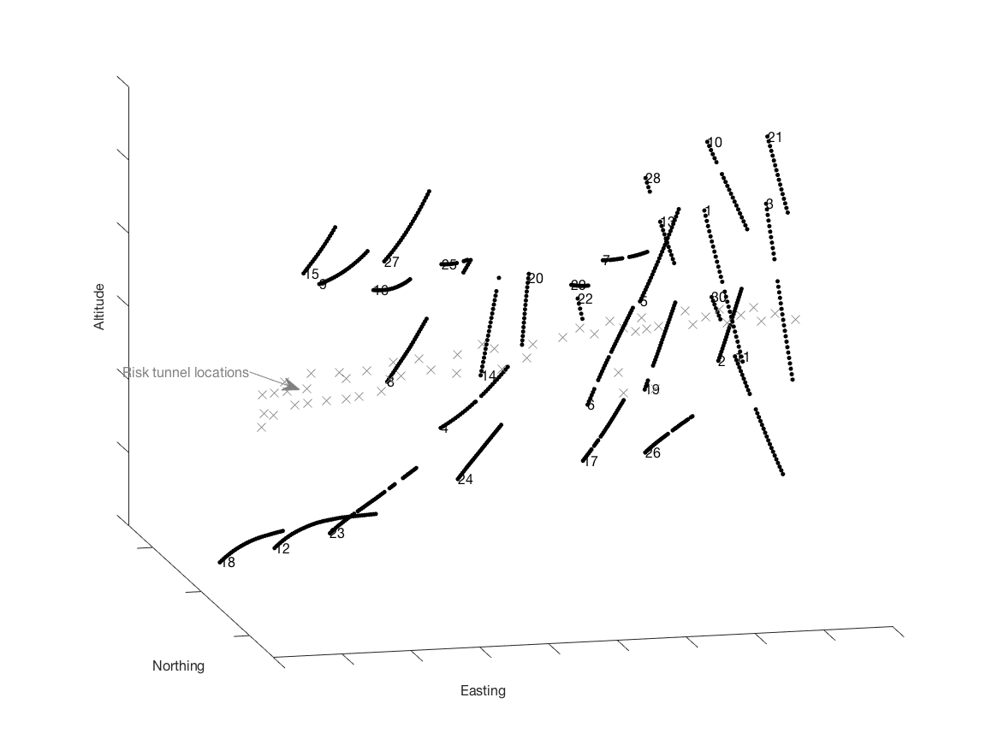
Mining risk locations and boreholes
.
Is the borehole data valuable for rock-hazard decisions?

Slide 24
Mining risk locations and boreholes
.
Sequential data gathering opportunities:
- drill one borehole at the time, process data, see model result, then consider if more data should be gathered, and where.

Slide 25
Models for mining risk and data
Prior for joints.
Likelihood,
design matrix, picks borehole locations.
The Poisson counts are rather large, Gaussian model is a reasonable approximation.

Slide 26
Conditioning – Gaussian models

Slide 27
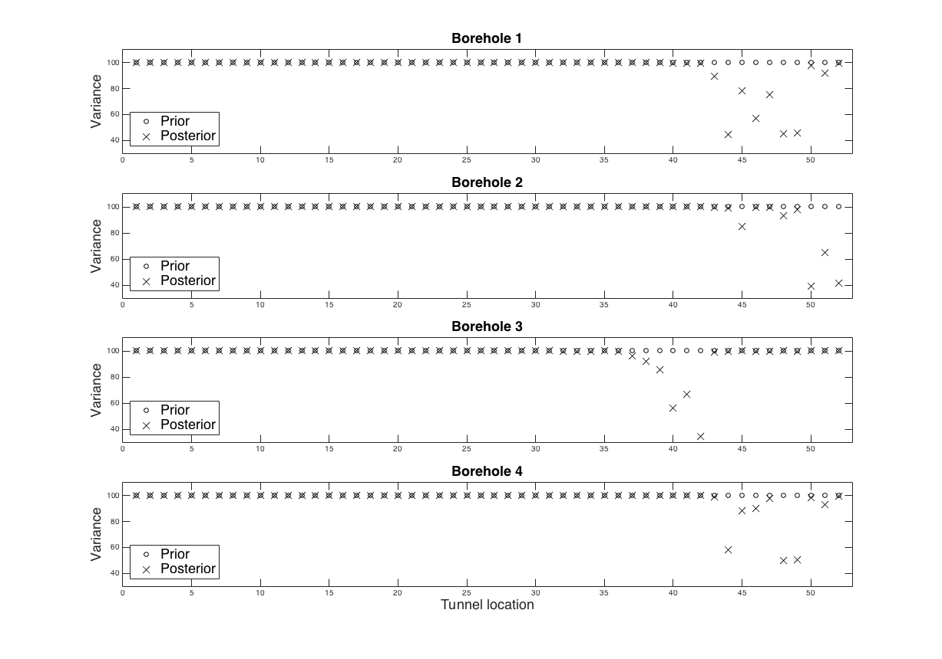
Mining risk – variance reduction
.
Information gathering in single boreholes.

Slide 28
VOI - Gaussian models
High flexibility:
Can select individual units.
Value decouples to sum.
standard Gaussian density and cumulative function

Slide 29
Mining risk – myopic scheme
.
Find best single borehole posterior values, if any.
Collect data in this borehole.
Update the model
Stop testing or continue testing.
Etc….
Find largest among all k.

Slide 30
Mining risk - results
.
We compare myopic with other strategies.
 | Static | Naive | Naive + | Myopic
VOI(1) | 3.6 | 5.9 | 13.5 | 17.0
Ave.depth | 1 | 2.4 | 6.5 | 8.7
There is clearly much to gain by having the opportunity to do sequential tests.

Slide 31
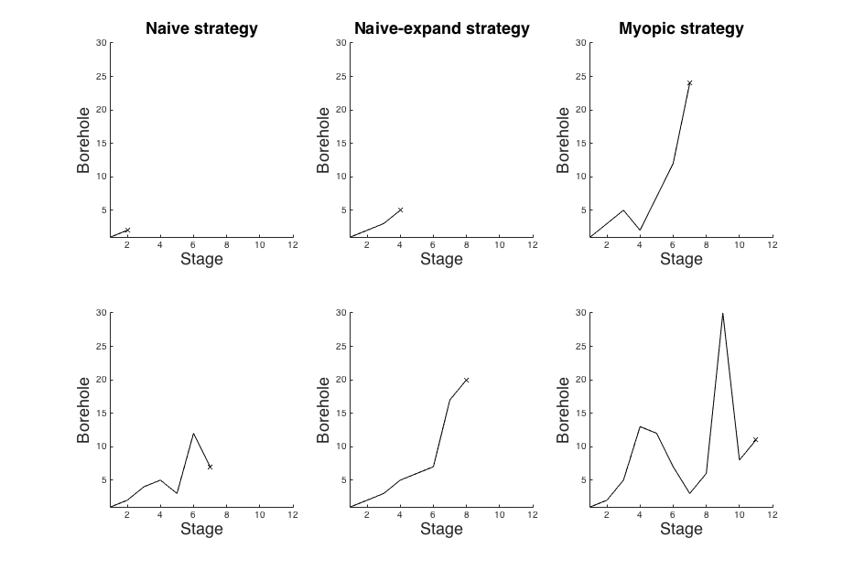
Mining risk – ‘depths’ for two data samples
.

Slide 32
Mining risk - results
.
We compare results for two different correlations.
Corr:225m | Static | Naive | Naive + | Myopic
VOI(1) | 3.6 | 5.9 | 13.5 | 17.0
Ave.depth | 1 | 2.4 | 6.5 | 8.7
Corr:300m | Static | Naive | Naive + | Myopic
VOI(1) | 5.1 | 8.0 | 18.6 | 25.3
Ave.depth | 1 | 2.4 | 5.6 | 10.2
For all strategies value increases with more correlation.
The depth (number of stages) of myopic increases with more correlation.
Myopic takes 100 x more computing time than static.
How much better would more complex strategies do?? Unknown.

Slide 33
AUV temperature example
Goal (value) is to detect large spatial gradients in ocean temperature.
Autonomous underwater vehicle (AUV) information. Where? And in what sequence?
Model for temperature is represented by Gaussian spatial process.
VOI analysis uses analytical approach and myopic heuristics.
Fossum et al., 2017.

Slide 34
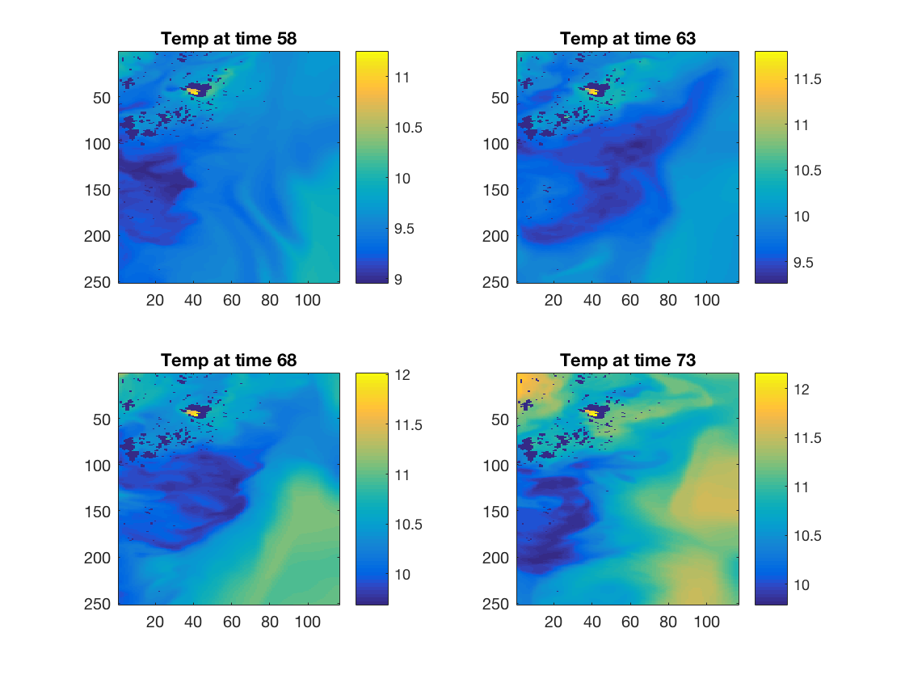
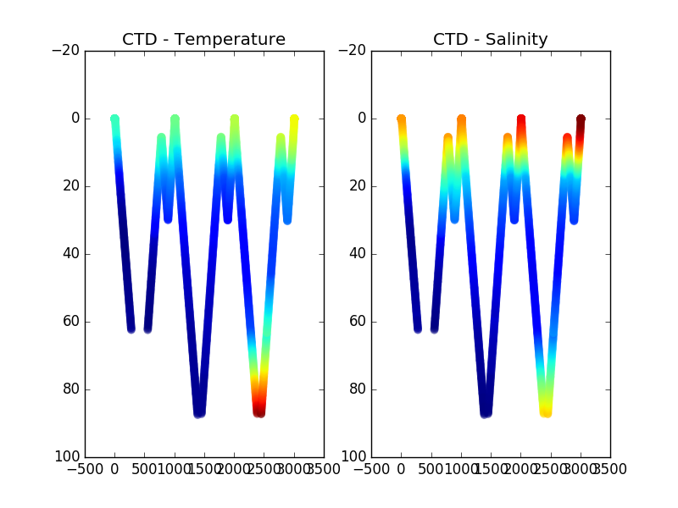
Classifying ocean temperature variability
Prior realizations
Questions:
Environmental challenges
Fish farming
Algae bloom
Typical AUV data

Slide 35
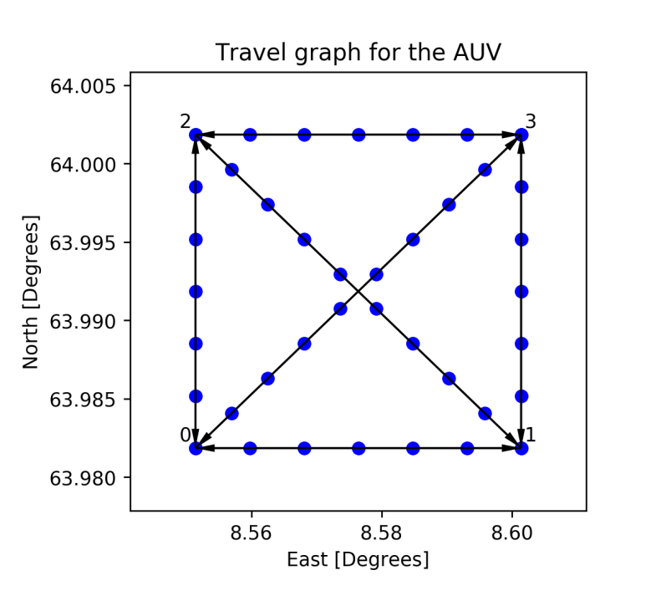
Gaussian prior and likelihood
Gaussian spatial process prior for temperatures.
Likelihood, design matrix, picks data locations, for every time step.

Slide 36
Goal of surveying
The main task for the AUV is to detect large gradients in temperature which are linked to algea bloom.
Waypoints in survey design for AUV.

Slide 37
Adaptive sequential algorithm
Find next best survey line (if any) from analytic VOI, of all possible survey lines.
Collect temperature data along currently best survey line.
Update temperature model in entire spatial domain given survey data.
Go to 1.
Myopic heuristic for dynamic program.

Slide 38
Results of adaptive algorithm
Mean of one survey realization
Variance of one survey realization

Slide 39
Wrap up:
.
VOI is applied to a sequential search for good data designs.
The design will depend on the data, and the results can be averaged over the data, to approximate value of different strategies.
The process is spatio-temporal – extensions required.

Slide 40
Project: Sequential VOI in Gaussian models
Consider again the 25x25 grid, with a Gaussian process prior.
Assume the situation from Norwegian wood example, with low decision flexibility, harvest all or nothing.
Use the myopic strategy to find sequential data designs along the 25 North-South lines. The price of a test is P=0.1.
How many tests are done before we stop? (varies with data samples)
What tests are usually done? (varies with data samples)

Slide 41
Myopic scheme
.
Find best single NS line, if any.
Collect data for this line.
Update the model
Stop testing or continue testing.
Etc….
Find largest among all k.
Use updated mean and covariances.

Slide 42
Suggested solutions to projects
http://folk.ntnu.no/joeid/Monday_project.m
http://folk.ntnu.no/joeid/Tuesday_project.m
http://folk.ntnu.no/joeid/Wednesday_project.m
http://folk.ntnu.no/joeid/Thursday_project.m
http://folk.ntnu.no/joeid/Friday_project.m

