Slide 1
Value of Information Analysis in Spatial Models
Jo Eidsvik
Jo.eidsvik@ntnu.no

Slide 2
My background:
Professor of Statistics at NTNU in Trondheim, NORWAY.
Education:
MSc in Applied Mathematics, Univ of Oslo
PhD in Statistics, NTNU
Work experience:
Norwegian Defense Research Establishment
Statoil
Research interests:
Spatial statistics, spatio-temporal statistics,
Computational statistics, sampling methods, fast approximation techniques,
Geoscience applications,
Design of experiments,
Decision analysis, value of information,
I like hiking, skiing, tennis, etc.

Slide 3
Plan for course
Time | Topic
Monday | Introduction and motivating examples
 | Elementary decision analysis and the value of information
Tuesday | Multivariate statistical modeling, dependence, graphs
 | Value of information analysis for dependent models
Wednesday | Spatial statistics, spatial design of experiments
 | Value of information analysis in spatial decision situations
Thursday | Examples of value of information analysis in Earth sciences
 | Computational aspects
Friday | Sequential decisions and sequential information gathering
 | Examples from mining and oceanography
Every day: Small exercise half-way, and computer project at the end.

Slide 4
Material:
Relevant background reading :
Eidsvik, J., Mukerji, T. and Bhattacharjya, D., Value of information in the Earth sciences,
Cambridge University Press, 2015.
Howard R.A. and Abbas, A.E., Foundations of decision analysis,
Pearson, 2015.
Many spatial statisics books:
- Cressie and Wikle (2011),
Chiles and Delfiner (2012),
Banerjee et al. (2014),
Pyrcz and Deutsch (2014),
etc.

Slide 5
Motivating VOI examples:
Integration of spatial modeling and decision analysis.
Collect data to resolve uncertainties and make informed decisions.

Slide 6
Motivation (a petroleum exploration example)
Gray nodes are petroleum reservoir segments where the company aims to develop profitable amounts of oil and gas.
Martinelli, G., Eidsvik, J., Hauge, R., and Førland, M.D., 2011, Bayesian networks for prospect analysis in the North Sea, AAPG Bulletin, 95, 1423-1442.

Slide 7
Motivation (a petroleum exploration example)
Gray nodes are petroleum reservoir segments where the company aims to develop profitable amounts of oil and gas.
Drill the exploration well at this segment!
The value of information is largest.

Slide 8
Motivation (a petroleum development example)
Reservoir predictions from post-stack seismic data!
Eidsvik, J., Bhattacharjya, D. and Mukerji, T., 2008, Value of information of seismic amplitude and CSEM resistivity, Geophysics, 73, R59-R69.

Slide 9
Motivation (a petroleum development example)
Reservoir predictions from post-stack seismic data!
Process pre-stack seismic data, or electromagnetic data?

Slide 10
Motivation (an oxide mining example)
Is mining profitable?
Eidsvik, J. and Ellefmo, S.L., 2013, The value of information in mineral exploration within a multi-Gaussian framework, Mathematical Geosciences, 45, 777-798.

Slide 11
Motivation (an oxide mining example)
What is the value of this additional information?
Is mining profitable?

Slide 12
Motivation (a groundwater example)
Which recharge location is better to prevent salt water intrusion?
Trainor-Guitton, W.J., Caers, J. and Mukerji, T., 2011, A methodology for establishing a data reliability measure for value of spatial information problems, Mathematical Geosciences, 43, 929-949.

Slide 13
Motivation (a groundwater example)
Which recharge location is better to prevent salt water intrusion?
Is it worthwhile to acquire electromagnetic data before making the decision about recharge?

Slide 14
Motivation (a hydropower example)
Adjusting water levels in 9 hydropower dams!

Slide 15
Motivation (a hydropower example)
Adjusting water levels in dams!
Acquire snow measurements?

Slide 16
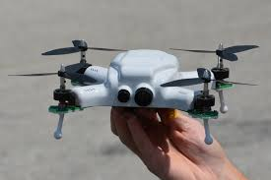
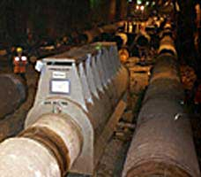
Other applications
Farming and forestry – how to set up surveys for improved harvesting decisions.
Biodiversity – where to monitor different biological variables for sustainability.
Environmental – how monitor where pollutants are, to minimize risk or damage.
Robotics - where should drone (UAV) or submarine (AUV) go to collect valuable data?
Industry reliability – how to allocate sensors to ‘best’ monitor state of system?
Internet of things – which sensors should be active now?

Slide 17
Which data are valuable?
Five Vs of big data:
Volume
Variety
Velocity
Veracity
Value
We must acquire and process data that has value!
There is often a clear question that one aims to answer, and data should help us.

Slide 18
Value of information (VOI)
In many Earth science applications we consider purchasing more data before making difficult decisions under uncertainty.
The value of information (VOI) is useful for quantifying the value of the data, before it is acquired and processed.
ECONOMIC
This pyramid of conditions - VOI is different from other information criteria (entropy, variance, prediction error, etc.)

Slide 19
Information gathering
Why do we gather data?
To make better decisions!
To answer some kind of questions!
Reject or strengthen hypotheses!
We will use a decision theoretic perspective, but the methods are easily adapted to other criteria or value functions (Wednesday).

Slide 20
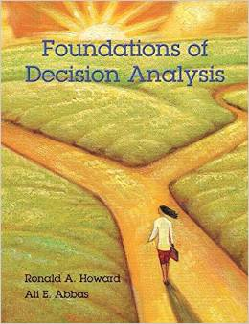
Decision analysis (DA)
Decision analysis attempts to guide a decision maker to clarity of action in dealing with a situation where one or more decisions are to be made, typically in the face of uncertainty.
Howard, R.A. and Abbas, A., 2015, Foundations of Decision Analysis, Prentice Hall.

Slide 21
Framing a decision situation
Rules of actional thought. (Howard and Abbas, 2015)
Frame your decision situation to address the decision makers true concerns.
Base decisions on maximum expected utility.
‘…systematic and repeated violations of these principles will result in inferior long-term consequences of actions and a diminishes quality of life…’
(Edwards et al., 2007, Advances in decision analysis: From foundations to applications, Cambridge University Press.)

Slide 22
Pirate example (For motivating decision analysis and VOI)

Slide 23
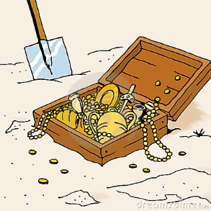
Pirate example
Pirate example: A pirate must decide whether to dig for a treasure, or not. The treasure is absent or present (uncertainty).
?
Pirate makes decision based on preferences and maximum utility or value!
Digging cost.
Revenues if he finds the treasure .

Slide 24
Pirate example
Pirate example: A pirate must decide whether to dig for a treasure, or not. The treasure is absent or present (uncertainty).
?
Pirate makes decision based on preferences and maximum utility or value!
Digging cost.
Revenues if he finds the treasure .

Slide 25
Mathematics of decision situation:
Alternatives
Uncertainties (probability distribution)
Values
Maximize expected value

Slide 26
Pirate’s decision situation
Risk neutral!

Slide 27
Decision trees
A way of structuring and illustrating a decision situation.
Squares represent decisions
Circles represent uncertainties
Probabilities and values are shown by numbers.
Arrows indicate the optimal decision.

Slide 28
Kim’s party problem
Howard, R.A. and Abbas, A., 2015, Foundations of Decision Analysis, Prentice Hall.
Sun (0.4)
$?
Outdoor
Rain (0.6)
$?
Sun (0.4)
$?
Porch
Rain (0.6)
$?
Sun (0.4)
$?
Indoors
Rain (0.6)
$?

Slide 29
Kim’s party problem
Sun (0.4)
$100
Outdoor
Rain (0.6)
$0
Sun (0.4)
$90
Porch
Rain (0.6)
$20
Sun (0.4)
$40
Indoors
Rain (0.6)
$50

Slide 30
Kim’s party problem
Sun (0.4)
$100
Outdoor
$40
Rain (0.6)
$0
Sun (0.4)
$90
Porch
$48
Rain (0.6)
$20
Sun (0.4)
$40
Indoors
$46
Rain (0.6)
$50

Slide 31
Kim’s party problem
Sun (0.4)
$100
Outdoor
$40
Rain (0.6)
$0
Sun (0.4)
$90
×
Porch
$48
Rain (0.6)
×
$20
Sun (0.4)
$40
Indoors
$46
Rain (0.6)
$50

Slide 32
Pirate’s decision situation

Slide 33
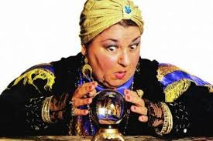
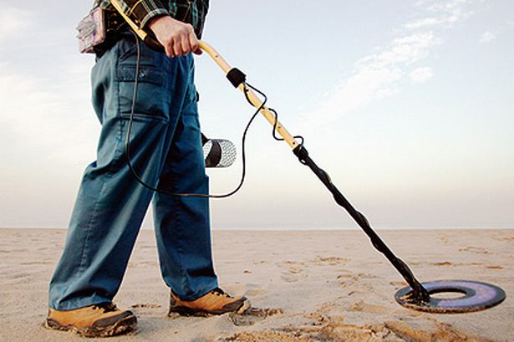
Pirate example
Pirate example: A pirate must decide whether to dig for a treasure, or not. The treasure is absent or present (uncertainty).
Pirate can collect data before making the decision, if the experiment is worth its price!
Perfect information.
Clairvoyant!
Imperfect information.
Detector!

Slide 34
Value of information (VOI)
VOI analysis is used to compare the additional value of making informed decisions with the price of the information.
If the VOI exceeds the price, the decision maker should purchase the data.
VOI=Posterior value – Prior value

Slide 35
VOI – Pirate considers clairvoyant
Conclusion: Consult clairvoyant if (s)he charges less than $1000.

Slide 36
PoV – decision tree, perfect information
Dig
$100 K
$100 K
Treasure (0.01)
×
Don’t dig
$0 K
$1 K
Dig
-$10 K
No treasure (0.99)
×
0 K
Don’t dig
$0 K

Slide 37
Pirate example - detector
Pirate example: A pirate must decide whether to dig for a treasure, or not. The treasure is absent or present (uncertainty).
Pirate can collect data before making the decision, if the experiment is worth its price!
Pirate makes decision based on preferences and maximum expected value!
Digging cost.
Revenues if he finds the treasure .

Slide 38
Pirate example - detector
Pirate example: A pirate must decide whether to dig for a treasure, or not. The treasure is absent or present (uncertainty).
Pirate can collect data with a detector before making the decision, if this experiment is worth its price!
Pirate makes decision based on preferences and maximum expected value!
Digging cost.
Revenues if he finds the treasure .

Slide 39
Detector experiment
Accuracy of test:
Should the pirate pay to do a detector experiment?
Does the VOI of this experiment exceed the price of the test?

Slide 40
Bayes rule - Detector experiment

Slide 41
Bayes rule - Detector experiment
Likelihood:
Marginal likelihood:
Posterior:

Slide 42
VOI – Pirate considers detector test
Conclusion: Purchase detector testing if its price is less than $460.

Slide 43
PoV - imperfect information
Treasure (0.16)
$100 K
Dig
$7.71 K
$7.71 K
No treasure (0.84)
“Positive” (0.06)
- $10 K
×
Don’t dig
$0 K
Treasure (0.0005)
$0.46 K
$100 K
Dig
- $9.95 K
No treasure (0.9995)
“Negative” (0.94)
- $10 K
$0 K
×
Don’t dig
$0 K

Slide 44
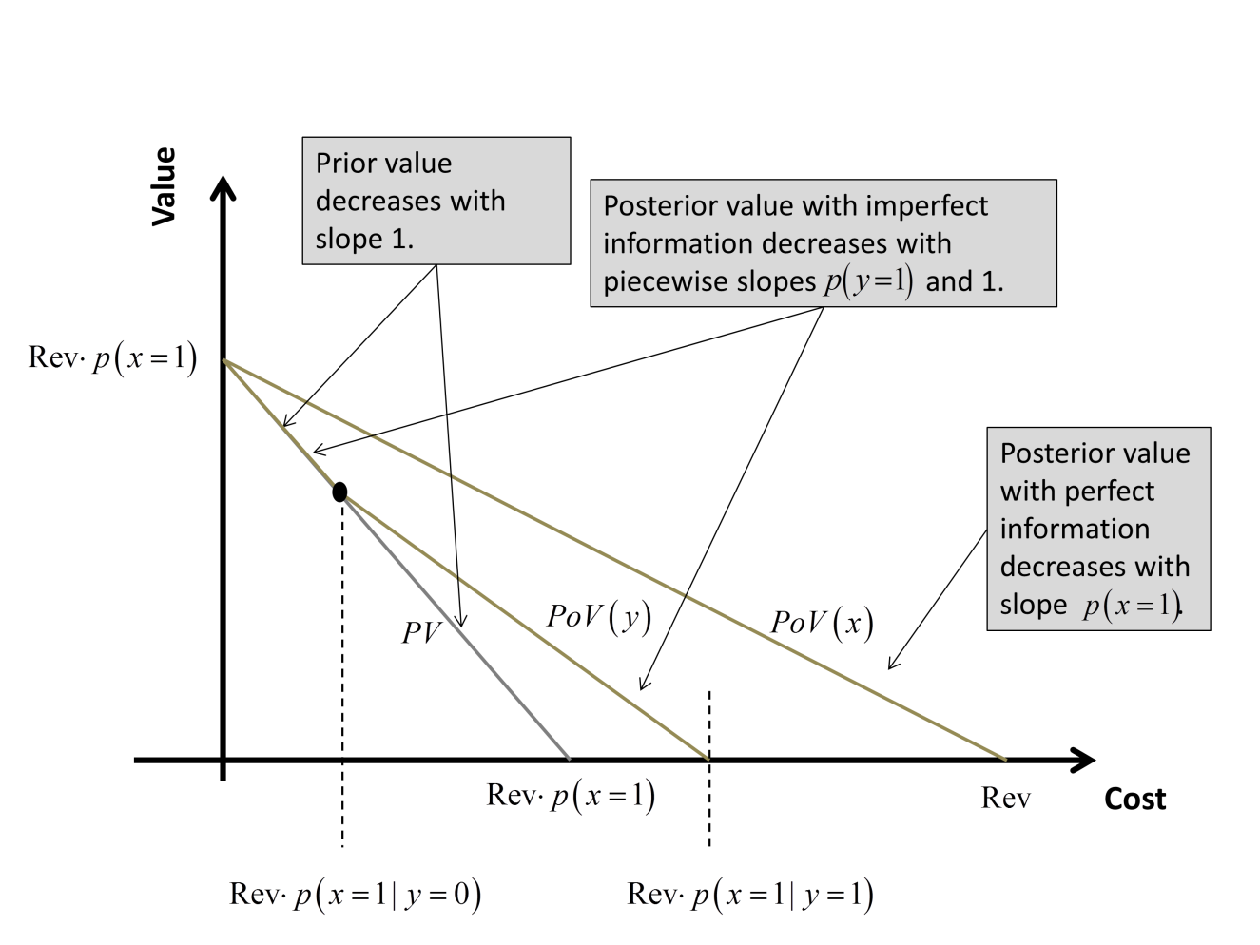
PV and PoV as a function of Digging Cost

Slide 45
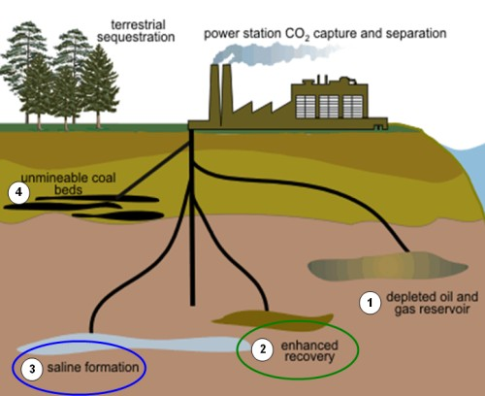
Exercise: CO2 sequestration
.
.
CO2 is sequestered to reduce carbon emission in the athmosphere and defer global warming.
Geological sequestration involves pumping CO2 in subsurface layers, where it will remain, unless it leaks to the surface.

Slide 46
VOI for CO2 sequestration
.
.
The decision maker can proceed with CO2 injection or suspend sequestration. The latter incurs a tax of 80 monetary units. The former only has a cost of injection equal to 30 monetary units, but the injected CO2 may leak (x=1). If leakage occurs, there will be a fine of 60 monetary units (i.e. a cost of 90 in total). Decision maker is risk neutral.
Data: Geophysical experiment, with binary outcome, indicating whether the formation is leaking or not.
Exercise:
Draw the decision tree without information.
Draw the decision tree with perfect information (clairvoyance).
Compute the VOI of perfect information.
Draw the decision tree with the geophysical experiment.
Compute conditional probabilities, expected values and the VOI of geophysical data.

Slide 47
Value of information (VOI) - More general formulation
VOI analysis is used to compare the additional value of making informed decisions with the price of the information.
If the VOI exceeds the price, the decision maker should purchase the data.
VOI=Posterior value – Prior value

Slide 48
Risk and utility functions
Exponential and linear utility have constant risk aversion coefficient:

Slide 49
Certain equivalents (CE)
Utilities are mathematical. The certain equivalent is a measure of how much a situation is worth to the decision maker. (It is measured in value).
What is the value of indifference? How much would the owner of a lottery be willing to sell it for?

Slide 50
VOI - Clairvoyance
Price P of experiment makes the equality.
VOI=Posterior value – Prior value
Assuming risk neutral decision maker!

Slide 51
Value of information- Imperfect
Price of indifference.
VOI=Posterior value – Prior value
Assuming risk neutral decision maker!

Slide 52
Properties of VOI
a) VOI is always positive
Data allow better, informed decisions.
b) If value is in monetary units ,VOI is in monetary units.
c) Data should be purchased if VOI > Price of experiment P.
d) VOI of clairvoyance is an upper bound for any imperfect information gathering scheme.
e) When we compare different experiments, we purchase the one with largest VOI compared with the price:

Slide 53
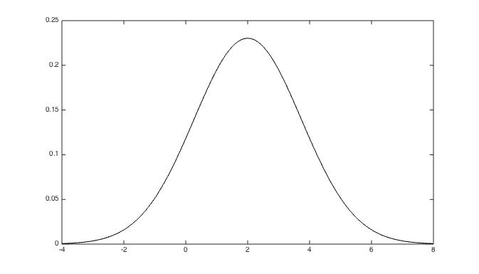
Gaussian model for profits
Gaussian, m=2, r=3
Uncertain profits of a project is Gaussian distributed.

Slide 54
VOI for Gaussian
Uncertain project profit is Gaussian distributed.
Invest or not?
The decision maker asks a clairvoyant for perfect information, if the VOI is larger than her price.

Slide 55
VOI for Gaussian
Result:

Slide 56
VOI for Gaussian
Gaussian cdf
Gaussian pdf
Result:
The analytical form facilitates computing, and eases the study of VOI properties as a function of the parameters.
The more uncertain, the more valuable is information.

Slide 57
What if several projects or treasures?

Slide 58
What if several projects or treasures?
C
A
P
B
Where to invest?
All or none? Free to choose as many as profitable? One at a time, then choose again?
Where should one collect data? All or none? One only? Or two? One first, then maybe another?

Slide 59
VOI and Earth sciences
Alternatives are spatial, often with high flexibiliy in selection of sites, control rates, intervention, excavation opportunities, harvesting, etc.
Uncertainties are spatial, with multi-variable interactions . Often both discrete and continuous.
Value function is spatial, typically involving coupled features, say through differential equations. It can be defined by «physics» as well as economic attributes.
Data are spatial. There are plenty opportunities for partial, total testing and a variety of tests (surveys, monitoring sensors, electromagnetic data, , etc.)

Slide 60
Two-project example
Two correlated projects with uncertain profits.
Decision maker considers investing in project(s).

Slide 61
Gaussian projects example
Alternatives
Do not invest in project 1 (a1=0) - Invest in project 1 (a1=1)
Do not invest in project 2 (a2=0) - Invest in project 1 (a2=1)
Decision maker is free to select both, if profitable: Four sets of alternatives.
Uncertainty (random variable)
Profits are bivariate Gaussian.
Assume mean 0, variance 1 and fixed correlation.
Value decouples to sum of profits, if positive.
Information gathering
Report can be written about one project (assume perfect).
Report can be written about both projects (assume imperfect).

Slide 62
Gaussian projects example
Prior model for profits:

Slide 63
Gaussian projects example
Must solve the integral expression!
Need marginal for data!
Need conditonal expectation!

Slide 64
Perfect information about 1 project
Get information about second project because of correlation!

Slide 65
Imperfect information, both projects
Reduction in variances large, VOI is large.

Slide 66
Gaussian projects results

Slide 67
Gaussian projects results
Price of test.

Slide 68
Insight from Gaussian projects
Dependence matters – the more correlation, the larger VOI.
The relative increase is very clear for partial information. It is also larger when there is more measurement noise. (With perfect total information, dependence does not matter.)
Decision maker must compare the VOI with the price of information, and purchase the data if the VOI exceeds the price.

Slide 69
Plan for course
Time | Topic
Monday | Introduction and motivating examples
 | Elementary decision analysis and the value of information
Tuesday | Multivariate statistical modeling, dependence, graphs
 | Value of information analysis for dependent models
Wednesday | Spatial statistics, spatial design of experiments
 | Value of information analysis in spatial decision situations
Thursday | Examples of value of information analysis in Earth sciences
 | Computational aspects
Friday | Sequential decisions and sequential information gathering
 | Examples from mining and oceanography
Every day: Exercises half-way, and computer project at the end.

Slide 70
Project 1 : Gaussian projects
Implement the bivariate Gaussian projects example, with prior mean 0 and variance 1, correlation parameter and measurement noise st dev parameter.
Compute and plot the VOI for different correlation parameters (0.01-0.99) and a couple of st dev parameters (0.01-0.50)
Study the decision regions for no testing, partial (1 only) or total imperfect testing.
Decision regions are useful for comparing the VOI results of ‘no testing’, ‘partial’ or ‘total’ tests, with the price P1 of first test, and P2 of second test:
Use, say, correlation 0.7, measurement st dev 0.25, and prices (0.01-1) for P1 and P2.

