Slide 1
Statistics group
Uncertainty quantification
  Compared with many Machine learning or AI groups we are more focused on uncertainties and properties of methods and algorithms.
  Uncertainties are crucial for decision support systems.
Applied statistics
  Compared with many Statistics groups we are more focused on applications and algorithms, not so much on theorems and proofs.
  Collaborations in several application domains; medicine, neuroscience, biology, marine, reliability, petroleum, mining, etc.
Strong spatial and computational statistics focus.

Slide 2
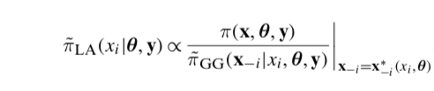
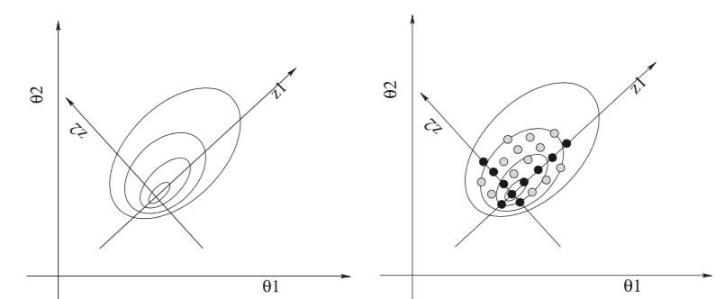
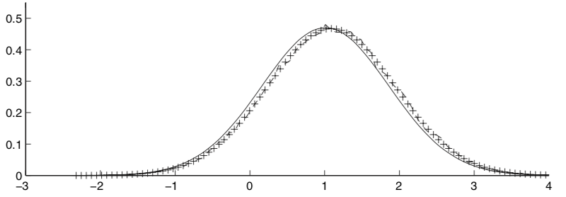
Integrated nested Laplace approximations (INLA) – Fast approximate Bayesian methods
Approach builds on Gaussian approximations and Laplace approximations (LA).
Numerical methods are used where they are suitable, instead of tedious sampling approaches.
INLA (solid)
MCMC (x--)
Results are produced in seconds, and comparable with Markov chain Monte Carlo (MCMC) methods which take hours.

Slide 3
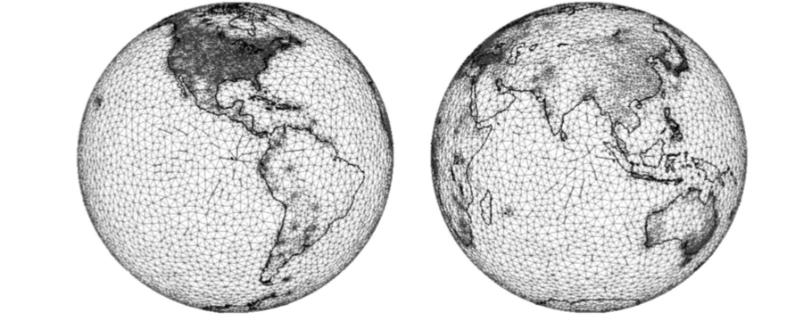

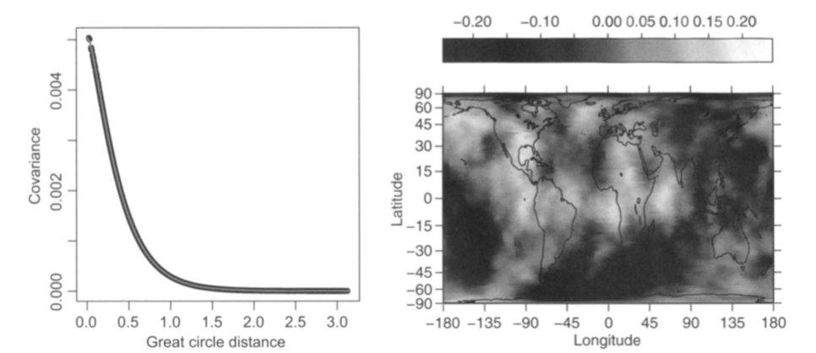
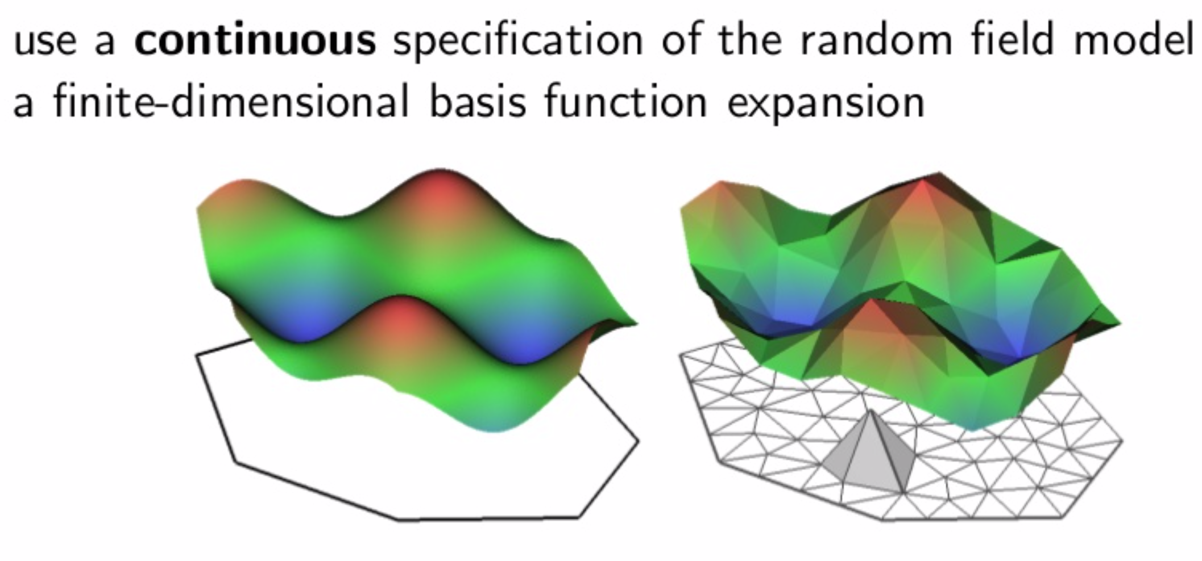
Spatial statistics

Slide 4
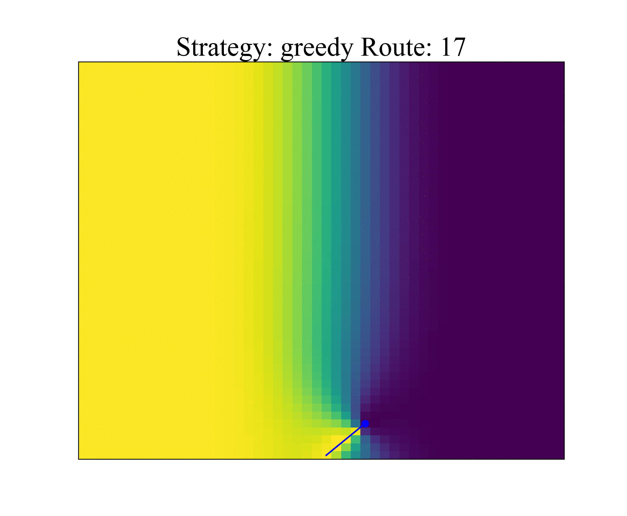
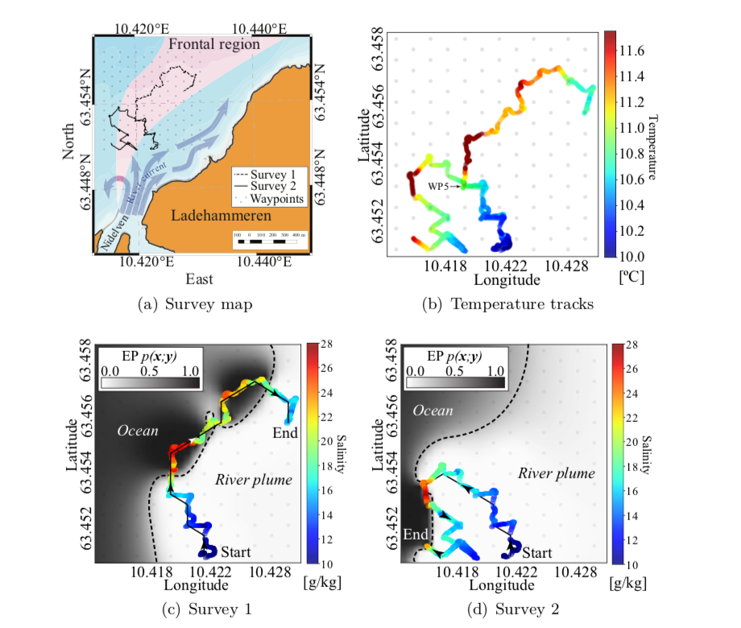
Data assimilation and optimal planning in spatio-temporal models
Autonomous search for excursion set of cold river water.

Slide 5
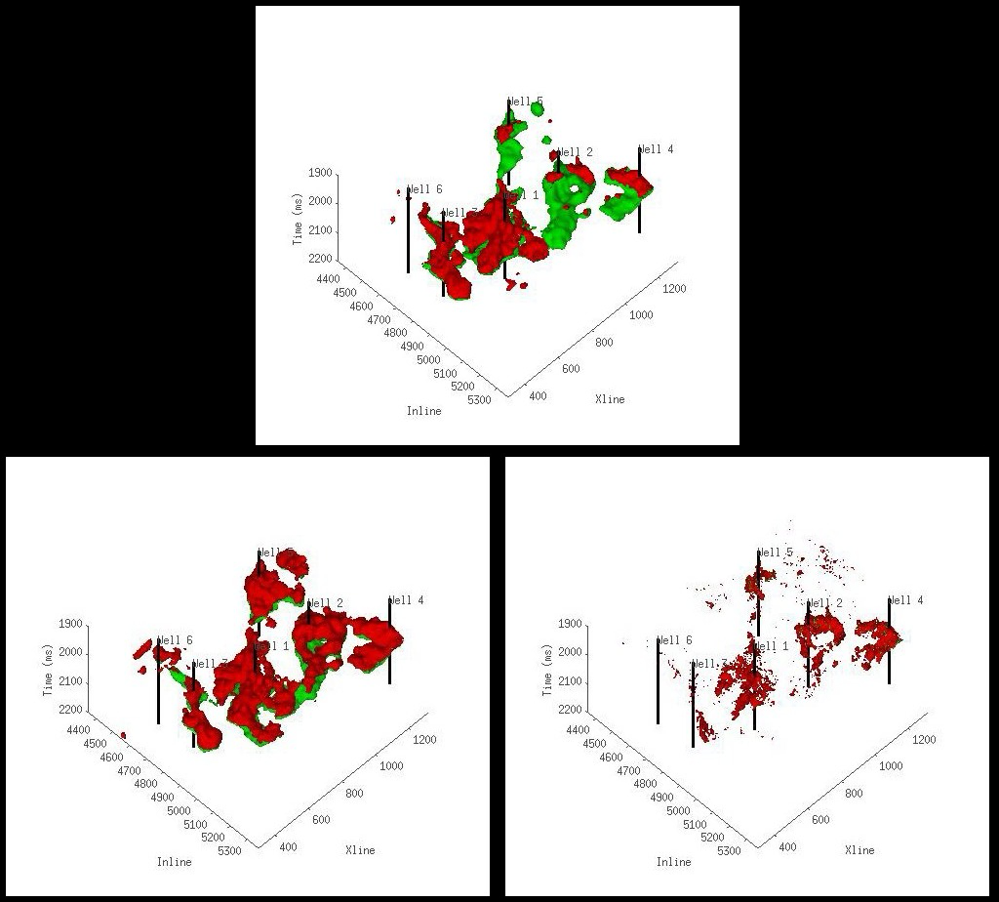
Uncertainty quantification for Earth resources
Green is oil, red is gas.
Bottom left model honors spatial statistical ordering and interactions.

