Slide 1
Data Assimilation Summer School Romania, 2025
Jo Eidsvik
Department of Mathematical Sciences,
NTNU, Norway
Jo.Eidsvik@ntnu.no

Slide 2
Plan
Time | Topic
Lecture 1 | Bayesian model updating
 | State space models
Lecture 2 | Design of experiments
 | Decision analysis and the value of information
Lecture 3 | Informative sampling designs in space-time
 | Examples with AUV surveying in the ocean
Lecture 4 | Value of information analysis / Sequential information gathering
 | Examples with CO2 storage monitoring in the subsurface
https://joeid.folk.ntnu.no/Romania25/

Slide 3
Bayesian model
All the currently available information is contained in the prior model for the variables:
New data (and the data gathering scheme) is represented by a likelihood model:
If we collect data, the model is updated to the posterior, conditional on the new observations:

Slide 4
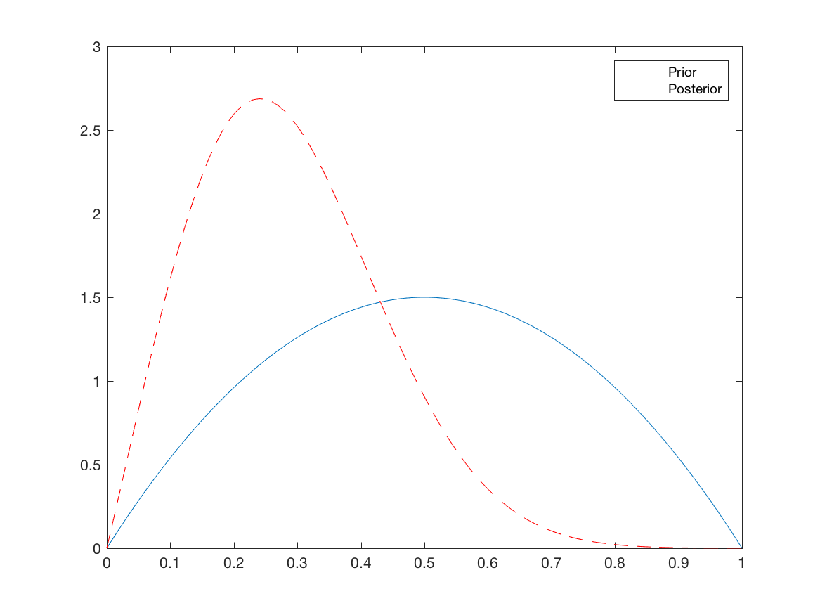
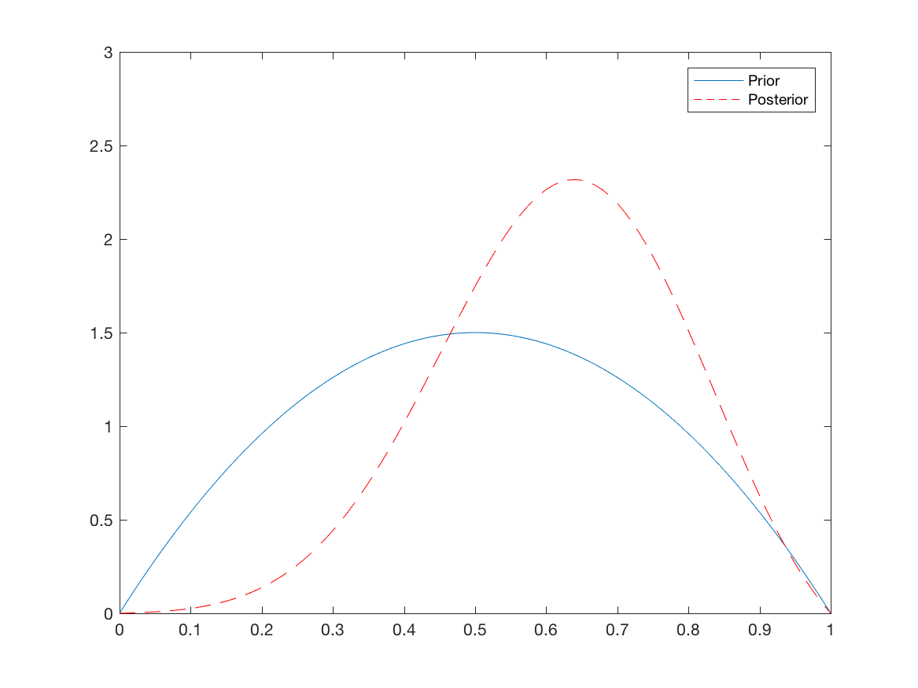
Bayesian updating
What data is valuable?
Study the expected effect of data, before it is collected.
We gather data not only to reduce uncertainty, but to make better decisions. We have a goal, a clear question we want to answer.

Slide 5
Criteria for acquiring valuable data
Reduce expected uncertainty
Largest variance reduction
Improved classification
Make better decisions
Balance cost and benefit

Slide 6
Variance reduction
Expected variance reduction:
For the Gaussian distribution:
The posterior variance does not depend on the data, only the data design.

Slide 7
Variance reduction (Gaussian, Kriging)
Overall variance reduction is larger for the random design.
This design matrix H gives a larger reduction term.

Slide 8
Entropy (Shannon)
Expected mutual information:

Slide 9
Entropy of a Gaussian
can have less entropy than
Since the entropy is the log determinant of the covariance matrix, the posterior entropy will not depend on the data, only the data design H.

Slide 10
Value of information (VOI)
We often consider purchasing more data before making difficult decisions under uncertainty.
The value of information (VOI) is useful for quantifying the value of the data, before it is acquired and processed.
This pyramid of conditions - VOI is different from other information criteria (entropy, variance, prediction error, etc.)

Slide 11
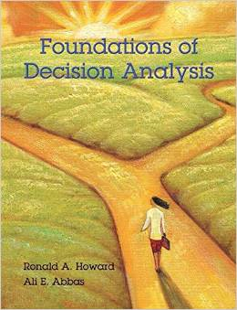
Decision analysis (DA)
Decision analysis attempts to guide a decision maker to clarity of action in dealing with a situation where one or more decisions are to be made, typically in the face of uncertainty.
Rules of actional thought. (Howard and Abbas, 2015)
Frame your decision situation to address the decision makers true concerns.
Base decisions on maximum expected utility.

Slide 12

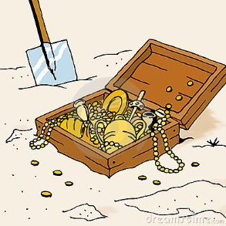
Pirate example
Pirate example: A pirate must decide whether to dig for a treasure, or not. The treasure is absent or present (uncertainty).
?
Pirate makes decision based on preferences and maximum utility or value!
Digging cost.
Revenues if he finds the treasure .

Slide 13
Pirate example
Pirate example: A pirate must decide whether to dig for a treasure, or not. The treasure is absent or present (uncertainty).
?
Pirate makes decision based on preferences and maximum utility or value!
Digging cost.
Revenues if he finds the treasure .

Slide 14
Mathematics of decision situation:
Alternatives
Uncertainties (probability distribution)
Values
Maximize expected value

Slide 15
Pirate’s decision situation
Risk neutral!

Slide 16
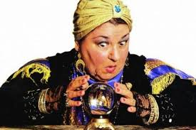
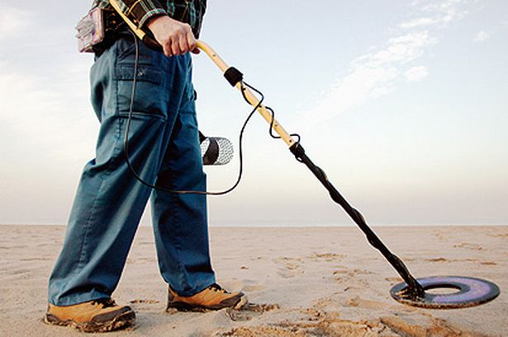
Pirate example
Pirate example: A pirate must decide whether to dig for a treasure, or not. The treasure is absent or present (uncertainty).
Pirate can collect data before making the decision, if the experiment is worth its price!
Perfect information.
Clairvoyant!
Imperfect information.
Detector!

Slide 17
Value of information (VOI)
VOI analysis is used to compare the additional value of making informed decisions with the price of the information.
If the VOI exceeds the price, the decision maker should purchase the data.
VOI=Posterior value – Prior value

Slide 18
VOI – Pirate considers clairvoyant
Conclusion: Consult clairvoyant if (s)he charges less than $1000.

Slide 19
PoV – decision tree, perfect information
Dig
$100 K
$100 K
Treasure (0.01)
×
Don’t dig
$0 K
$1 K
Dig
-$10 K
No treasure (0.99)
×
0 K
Don’t dig
$0 K

Slide 20
Pirate example - detector
Pirate example: A pirate must decide whether to dig for a treasure, or not. The treasure is absent or present (uncertainty).
Pirate can collect data before making the decision, if the experiment is worth its price!
Pirate makes decision based on preferences and maximum expected value!
Digging cost.
Revenues if he finds the treasure .

Slide 21
Pirate example - detector
Pirate example: A pirate must decide whether to dig for a treasure, or not. The treasure is absent or present (uncertainty).
Pirate can collect data with a detector before making the decision, if this experiment is worth its price!
Pirate makes decision based on preferences and maximum expected value!
Digging cost.
Revenues if he finds the treasure .

Slide 22
Detector experiment
Accuracy of test:
Should the pirate pay to do a detector experiment?
Does the VOI of this experiment exceed the price of the test?

Slide 23
Bayes rule - Detector experiment

Slide 24
Bayes rule - Detector experiment
Likelihood:
Marginal likelihood:
Posterior:

Slide 25
VOI – Pirate considers detector test
Conclusion: Purchase detector testing if its price is less than $460.

Slide 26
PoV - imperfect information
Treasure (0.16)
$100 K
Dig
$7.71 K
$7.71 K
No treasure (0.84)
“Positive” (0.06)
- $10 K
×
Don’t dig
$0 K
Treasure (0.0005)
$0.46 K
$100 K
Dig
- $9.95 K
No treasure (0.9995)
“Negative” (0.94)
- $10 K
$0 K
×
Don’t dig
$0 K

Slide 27
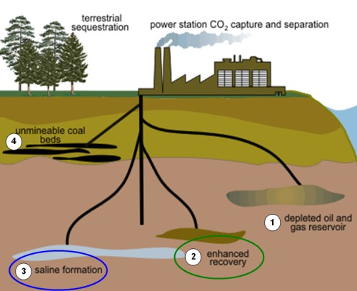
Exercise: CO2 sequestration
.
.
CO2 is sequestered to reduce carbon emission in the athmosphere and defer global warming.
Geological sequestration involves pumping CO2 in subsurface layers, where it will remain, unless it leaks to the surface.

Slide 28
VOI for CO2 sequestration
.
.
The decision maker can proceed with CO2 injection or suspend sequestration. The latter incurs a tax of 80 monetary units. The former only has a cost of injection equal to 30 monetary units, but the injected CO2 may leak (x=1). If leakage occurs, there will be a fine of 60 monetary units (i.e. a cost of 90 in total). Decision maker is risk neutral (using expected values).
Data: Geophysical experiment, with binary outcome, indicating whether the formation is leaking or not.
Exercise:
Draw the decision tree without information.
Draw the decision tree with perfect information (clairvoyance).
Compute the VOI of perfect information.
Draw the decision tree with the geophysical experiment.
Compute conditional probabilities, expected values and the VOI of geophysical data.

Slide 29
Properties of VOI
a) VOI is always positive
Data allow better, informed decisions.
b) If value is in monetary units ,VOI is in monetary units.
c) Data should be purchased if VOI > Price of experiment P.
d) VOI of clairvoyance is an upper bound for any imperfect information gathering scheme.
e) When we compare different experiments, we purchase the one with largest VOI compared with the price:

Slide 30
Decision analysis
Uncertain variables:
Alternatives (Where? How? When?)
Value function is revenues, subtracted costs.
Risk neutral decision maker will maximize expected value:

Slide 31
Value of information (VOI)
Prior value:
- Uncertainties
- Alternatives
- Value function
Posterior value:
- Data
VOI = Expected posterior value – Prior value

Slide 32
Information gathering
.
 | Perfect | Imperfect
Total | Exact observations are gathered for all locations. | Noisy observations are gathered for all locations.
Partial | Exact observations are gathered at some locations. | Noisy observations are gathered at some locations

Slide 33
Example of VOI analysis
Gray nodes are petroleum reservoir segments where the company aims to develop profitable amounts of oil and gas.

Slide 34
Bayesian network , reservoir segments
.
Model elicited with expert geologists.
Source migration of gas (and oil) from kitchens (K).
i) Local failure probability of migration and ii)

Slide 35
Prior marginal probabilities
.
Three possible classes at all nodes:
Dry
Gas
Oil

Slide 36
Prior values
Development fixed cost.
Infrastructure at prospect r.
.
Cost of drilling segment i.
Cost if dry,
0 otherwise.
Revenues of oil/gas,
0 otherwise.

Slide 37
Values
.
Most lucrative. But might not be most informative.

Slide 38
Posterior values and VOI
.
Data acquired at single well.

Slide 39
VOI single wells
.

Slide 40
VOI for different costs
.
Development fixed cost.

Slide 41
VOI for different costs
.
For each segment VOI starts at 0 (for small costs), grows to larger values, and decreases to 0 (for large costs).
VOI is smooth for segments belonging to the same prospect. Correlation and shared costs.
VOI can be multimodal as a function of cost, because the information influences neighboring segments, at which we are indifferent of at other costs.

Slide 42
Gaussian distribution and VOI
Computing the VOI in spatial Gaussian linear models.
- The spatial random variables are assumed to be Gaussian distributed
- Make good spatial designs (choose matrix H).
- The optimal design depends on the model and the decision situation.
Gaussian distribution is very common and analytical properties are available.

Slide 43
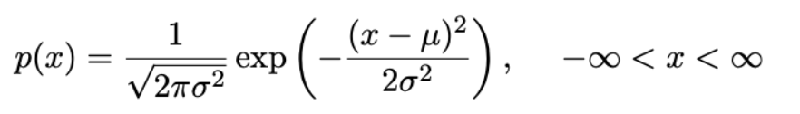
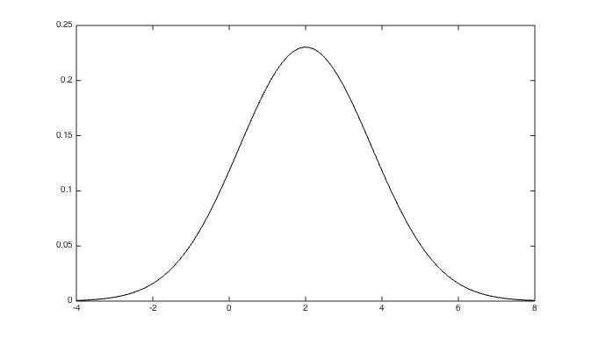
Gaussian profit
Uncertain profit of a project is Gaussian distributed.

Slide 44
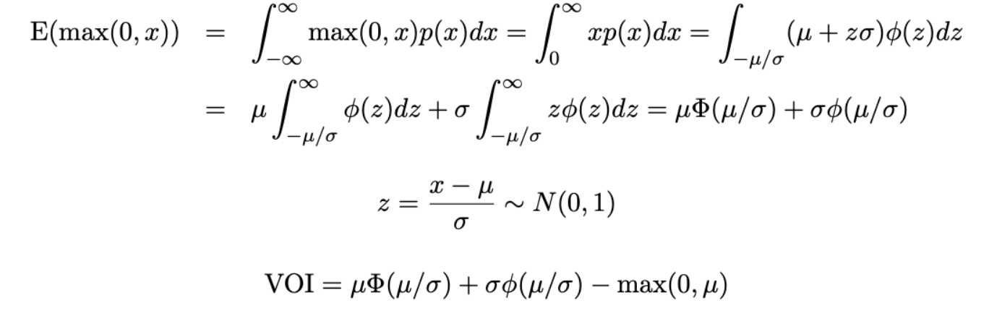
VOI for Gaussian project profits
Uncertain project profit is Gaussian distributed.
Invest or not?
The decision maker asks a clairvoyant for perfect information, if the VOI is larger than her price.

Slide 45

VOI for Gaussian
Gaussian cdf
Gaussian pdf
The analytical form facilitates computing, and eases the study of VOI properties as a function of the parameters.

Slide 46
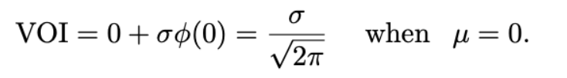
VOI for Gaussian
Gaussian cdf
Gaussian pdf
Result:
The VOI is largest with mean at 0, most difficult to make decision.
More uncertain -> information more valuable.

Slide 47
Multivariate Gaussian and VOI
Standard bivariate Gaussian:

Slide 48
Kriging
Overall variance reduction is larger for the random design.

Slide 49
Computation - Formula for VOI
Computations :
Easier with low decision flexibility ( less alternatives).
Easier if value decouples (sums or integrals split).
Easier for perfect, total, information (upper bound on VOI).
Sometimes analytical solutions (GAUSSIAN).
Otherwise approximations and Monte Carlo.

Slide 50
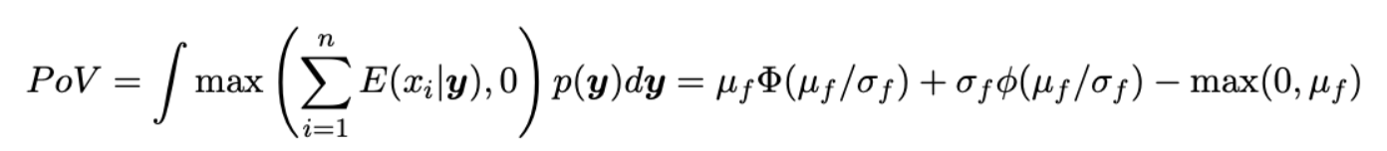
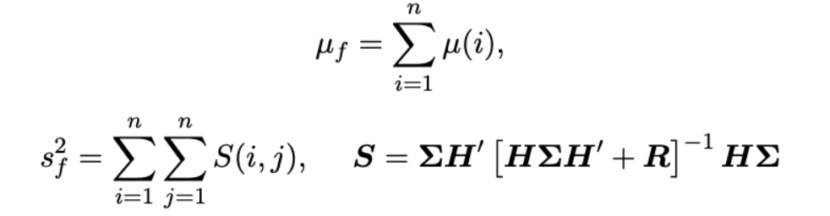
VOI – Gaussian models
Low flexibility:
Must select all units, or none.
Value decouples to sum.
Value function is linear.
Profits modeled directly.

Slide 51
Mining example
What is the value of this additional information?
Is mining profitable?

Slide 52
Decision situation and data
Planned boreholes.
Mining blocks. Some waste rock. Some high-grade.

Slide 53
Information gathering
Planned boreholes.
Total test : 265 measurements in 21 new boreholes.
Partial test: Drilling and sampling data only in a subset of boreholes.
Perfect testing (XRF: done in lab). Imperfect testing (XMET: handheld meter).

Slide 54
Prior model

Slide 55
Model

Slide 56
Prior and likelihood model
Prior trained from current data.
-XRF data
-XMET data
VOI analytically available for different data gathering opportunities.

Slide 57
VOI : Decision regions XRF,XMET.

Slide 58
VOI : Decision regions, partial data.

Slide 59
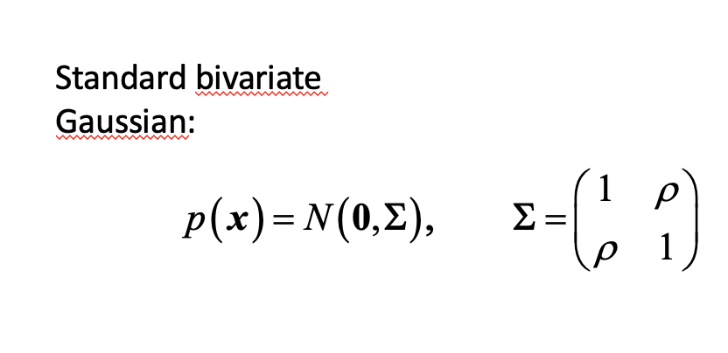
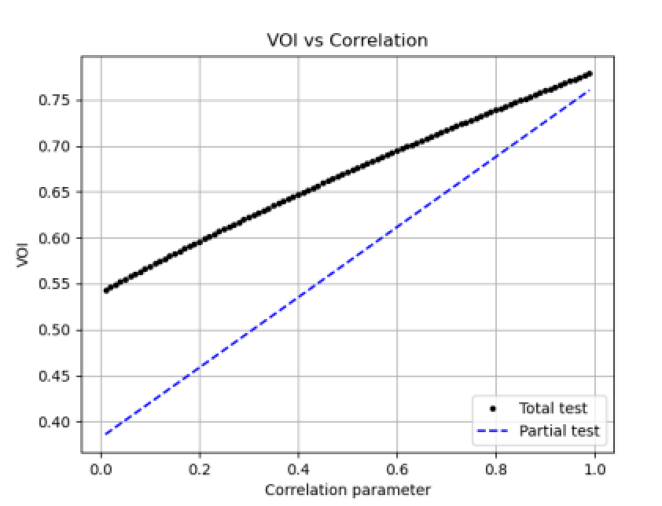
Exercise VOI bivariate Gaussian project
Compare a total and partial imperfect test.
Design matrix H=I vs H=[1,0].
Play with measurement noise, and see difference between partial and total tests.
https://joeid.folk.ntnu.no/Romania25/VOI_bivarGauss.py

