Slide 1
Value of Information Analysis in Spatial Models
Jo Eidsvik
Jo.eidsvik@ntnu.no

Slide 2
Plan for course
Time | Topic
Monday | Introduction and motivating examples
 | Elementary decision analysis and the value of information
Tuesday | Multivariate statistical modeling, dependence, graphs
 | Value of information analysis for dependent models
Wednesday | Spatial statistics, spatial design of experiments
 | Value of information analysis in spatial decision situations
Thursday | Examples of value of information analysis in Earth sciences
 | Computational aspects
Friday | Sequential decisions and sequential information gathering
 | Examples from mining and oceanography
Every day: Small exercise half-way, and computer project at the end.

Slide 3
Dependence? Does it matter?
Gray nodes are petroleum reservoir segments where the company aims to develop profitable amounts of oil and gas.
Martinelli, G., Eidsvik, J., Hauge, R., and Førland, M.D., 2011, Bayesian networks for prospect analysis in the North Sea, AAPG Bulletin, 95, 1423-1442.

Slide 4
Dependence? Does it matter?
Gray nodes are petroleum reservoir segments where the company aims to develop profitable amounts of oil and gas.
Drill the exploration well at this segment!
The value of information is largest.

Slide 5
Joint modeling of multiple variables
A
C
Spatial variables are often not independent!
To study if dependence matter, we need to model the joint properties of uncertainties.
What is the probability that variable A is 1 and, at the same time, variable B is 1 ?
What is the probability that variable C is 0, and both A and B are 1 ?
B

Slide 6
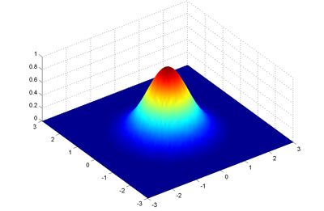
Joint pdf
Discrete sample space:
Probability mass function (pdf)
Continuous sample space:
Probability density function (pdf)

Slide 7
Multivariate statistical models
The joint probability mass or density function (pdf) defines all probabilistic aspects of the distribution!

Slide 8
Marginal and conditional probability
Marginalization in joint pdf.
Conditioning in joint pdf.
Conditional mean and variance

Slide 9
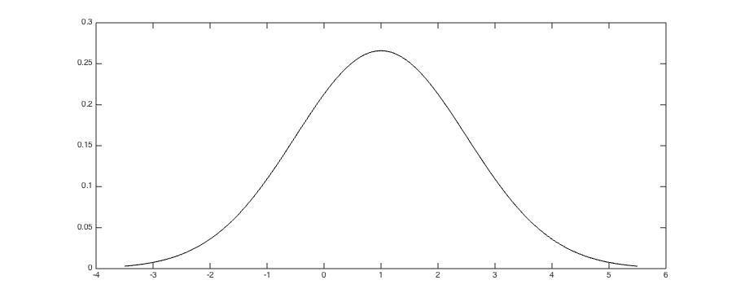
Marginalization

Slide 10
Conditional probability
Venn diagram
B
A

Slide 11
Conditional probability
Independence!
Must hold for all outcomes and for all subsets!
Unrealistic in most applications!
A

Slide 12
Modeling by conditional probability
The joint pdf can be difficult to model directly.
Instead we can build the joint pdf from conditional distributions.
Holds for any ordering of variables.
A

Slide 13
Modeling by conditional probability
Modeling by conditionals is done by conditional statements, not joint assessment:
What is likely to happen for variable K when variable L is 1?
What is the probability of variable C being 1 when variables A and B are both 0?
Such statements might be easier to specify,
and can more easily be derived from physical principles.
A

Slide 14
Modeling by conditional probability
Holds for any ordering of variables. Some conditioning variables can often be skipped.
Conditional independence in modeling.
This simplifies modeling and interpretation! And computing!
A

Slide 15
Modeling by conditional probability
Conditional independence:
A
P
C
B
What is the chance of success at B, when there is success at parent P?
What is the chance of success at B, when there is failure at parent P?
Must set up models for all nodes, using marginals for root nodes, and conditionals for all nodes with edges.
A

Slide 16
Bayesian networks and Markov chains

Slide 17
Bayesian networks and Markov chains

Slide 18
Bayesian networks and Markov chains

Slide 19
Bivariate petroleum prospects example
.
Conditional independence between prospect A and B, given outcome of parent!
Similar network models have been used in medicine/genetics, and testing for heritable diseases.

Slide 20
Exercise: Bivariate petroleum prospects example
Exercise:
Compute the conditional probability at prospect A, when one knows the success or failure outcome of prospect B.
Compare with marginal probability.

Slide 21
Bivariate petroleum prospects example
.
Joint | Failure prospect B | Success prospect B | Marginal probability
Failure prospect A | 0.85 | 0.05 | 0.9
Success prospect A | 0.05 | 0.05 | 0.1
Marginal probability | 0.9 | 0.1 | 1

Slide 22
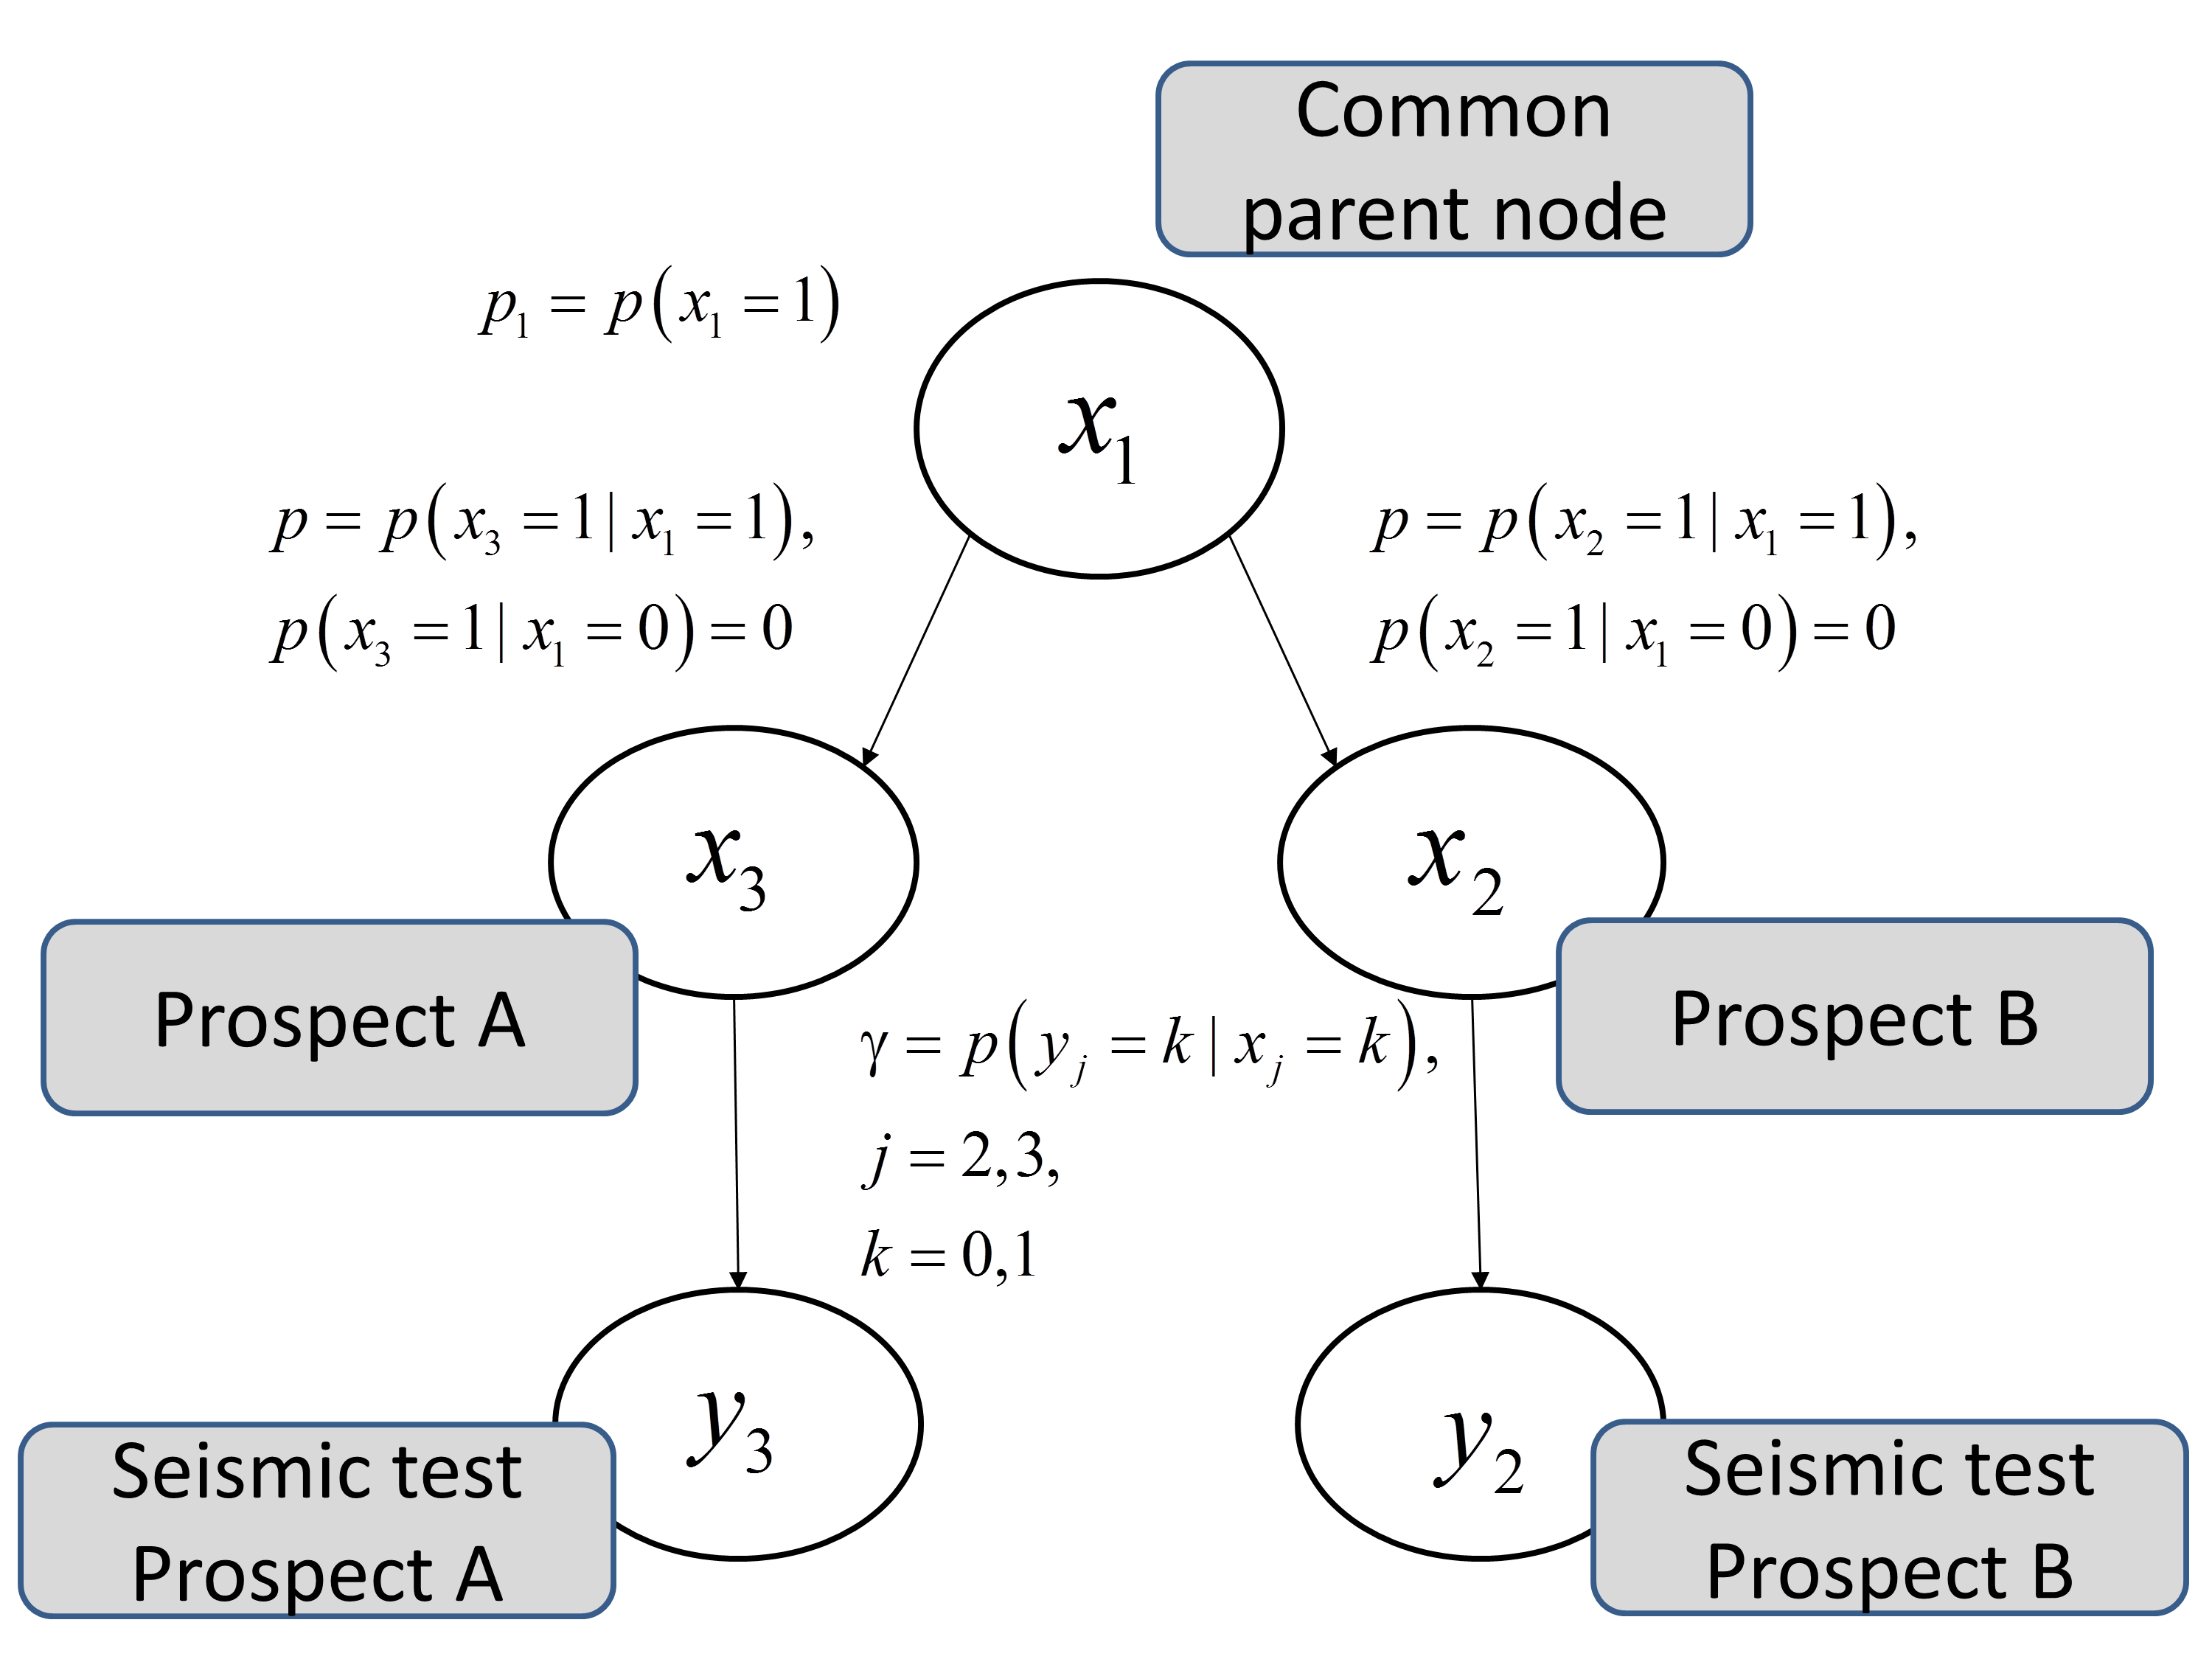
Example - Bivariate petroleum prospects
.
Collect seismic data :VOI - Should data be collected at both prospects, or just one of them? Partial or total? Imperfect or perfect?

Slide 23
Bivariate petroleum prospects
.
Need to frame the decision situation:
Can one freely select (profitable) prospects, or must both be selected.
Does value decouple?
Can one do sequential selection?
Need to study information gathering options:
Imperfect (seismic), or perfect (well data)?
Can one test both prospects, or only one (total or partial)?
Can one perform sequential testing?

Slide 24
Bivariate petroleum prospects
.
Need to frame the decision situation:
Can one freely select (profitable) prospects, or must both be selected. Free selection.
Does value decouple? Yes, no communication between prospects.
Can one do sequential selection? Non-sequential.
Need to study information gathering options:
Imperfect (seismic), or perfect (well data)? Study both.
Can one test both prospects, or only one (total or partial)? Study both.
Can one perform sequential testing? Not done here.

Slide 25
Bivariate prospects example - perfect
.
Assume we can freely select (develop) prospects, if profitable.
Total clairvoyant information

Slide 26
Bivariate prospects example - perfect
.
Assume we can freely select (develop) prospects, if profitable.
Partial clairvoyant information

Slide 27
Bivariate prospects example - imperfect
.
Define sensitivity of seismic test (imperfect):

Slide 28
Bivariate prospects example - imperfect
.
Assume we can freely select (develop) prospects, if profitable.
Total imperfect information
Can also purchase imperfect partial information i.e. about one of the prospects?

Slide 29
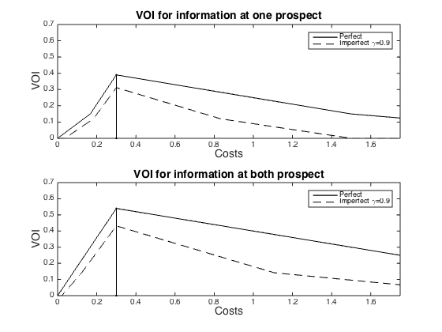
VOI for bivariate prospects example
.
Imperfect total better then partial perfect.
Partial perfect is better than imperfect total.

Slide 30
VOI for bivariate prospects example
.
Price of test is 0.3
Imperfect total better then partial perfect.
Partial perfect is better than imperfect total.

Slide 31
Insight in VOI – Bivariate prospects
.
VOI of partial testing is always less than total testing, with same accuracy.
Total imperfect test can give less VOI than a partial perfect test. Difference depends on the accuracy, prior mean for values, and correlation in spatial model.
VOI is small for low costs (easy to start development) and for high cost (easy to avoid development). We do not need more data in these cases. We can make decisions right away.

Slide 32
Larger networks - computation
Algorithms have been developed for efficient marginalization, conditioning.
Martinelli, G., Eidsvik, J., Hauge, R., and Førland, M.D., 2011, Bayesian networks for prospect analysis in the North Sea, AAPG Bulletin, 95, 1423-1442.

Slide 33
VOI workflow
Develop prospects separately. Shared costs for segments within one prospect.
Gather information by exploration drilling. One or two wells. No opportunities for adaptive testing.
Model is a Bayesian network model elicited from expert geologists in this area.
VOI analysis done by exact computations for Bayesian networks (Junction tree algorithm – efficient marginalization and conditioning).

Slide 34
Bayesian network , Kitchens
.
Model elicited from experts.
Migration from kitchens.
Local failure probability of migration.

Slide 35
Prior marginal probabilities
.
Three possible classes at all nodes:
Dry
Gas
Oil

Slide 36
Prior values
Development fixed cost.
Infrastructure at prospect r.
.
Cost of drilling segment i.
Cost if dry, 0 otherwise.
Revenues of oil/gas, 0 otherwise.

Slide 37
Values
.
Most lucrative. But might not be most informative.

Slide 38
Posterior values and VOI
.
Data acquired at single well.

Slide 39
VOI single wells
.
Development fixed cost.

Slide 40
VOI for different costs
.
Development fixed cost.

Slide 41
VOI for different costs
.
For each segment VOI starts at 0 (for small costs), grows to larger values, and decreases to 0 (for large costs).
VOI is smooth for segments belonging to the same prospect. Correlation and shared costs.
VOI can be multimodal as a function of cost, because the information influences neighboring segments, at which we are indifferent at other costs.

Slide 42
Take home from this exercise:
.
VOI is not largest at the most lucrative prospects.
VOI is largest where more data are likely to help us make better decisions.
VOI also depends on whether the data gathering can influence neighboring segments – data propagate in the Bayesian network model.
Compare with price? Or compare different data gathering opportunities, and provide a basis for discussion.

Slide 43
Never break the chain - Markov models
Markov chains are special graphs, defined by initial probabilities and transition matrices.
Independence
Absorbing

Slide 44
Markov chains (given perfect information)

Slide 45
Never break the chain - Hidden Markov model
Latent variable is a Markov chain. This forms the prior model.
Data are measured, imperfectly, at all or some of the variables.
- Commonly used for speech recognition, translation, cleaning signals, etc.

Slide 46
Modeling by conditional probability
Prior:
Likelihood:
Conditionally independent data. Data measures the local properties:
When the latent variable at that location is known, there is nothing to add by knowing other variables.
A

Slide 47
Hidden Markov model
Goal is:

Slide 48
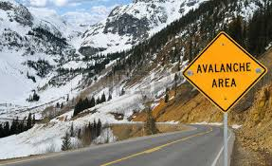
Avalanche decisions and sensors
Suppose that parts along a road or railroad are at risk of avalanche.
- One can remove risk by cost.
- If it is not removed, the repair cost depends on the unknown risk class.
Data, typically putting out sensors, can help classify the risk class and hence improve the decisions made at different locations.

Slide 49
Avalanche decisions - risk analysis
n=50 identified locations, at risk of avalanche.
At every location one can remove risk by cost 10.
If it is not removed, the repair cost depends on the unknown risk class:
Decision maker can secure, or not, at each location. The decisions are based on the minimization of expected costs.
Prior value:

Slide 50
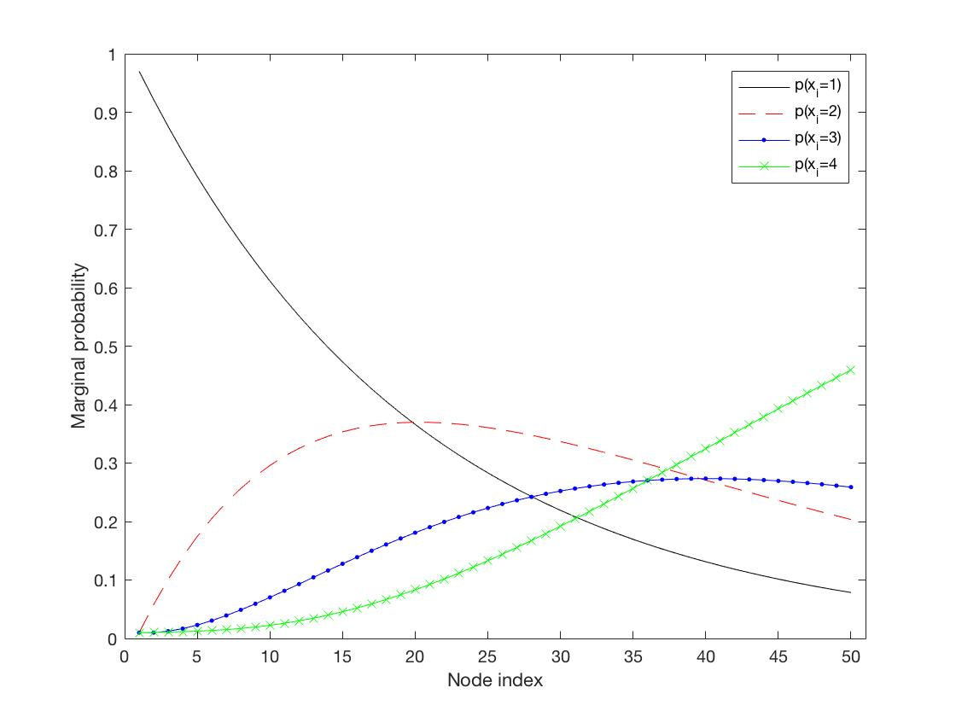
Never break the chain - Prior model

Slide 51
Never break the chain - Data model
Sensors at some or all of the n=50 identified locations.
Likelihood model:
Posterior value:
Site is measured by sensor:
Site is not measured by sensor:
This is a trick to make the forward-backward algorithm easier to implement.

Slide 52
Forward-backward algorithm
Recursive forward step (prediction and updating):

Slide 53
Forward-backward algorithm
Recursive backward step :

Slide 54
Monte Carlo approximation for VOI
Sample B Markov chain variables, and next sample B data vectors.
- The samples will be from the marginal distribution for the data.
Compute the marginal posterior probabilities by forward-backward algorithm for each data sample.
Average the results to approximate posterior value and VOI.

Slide 55
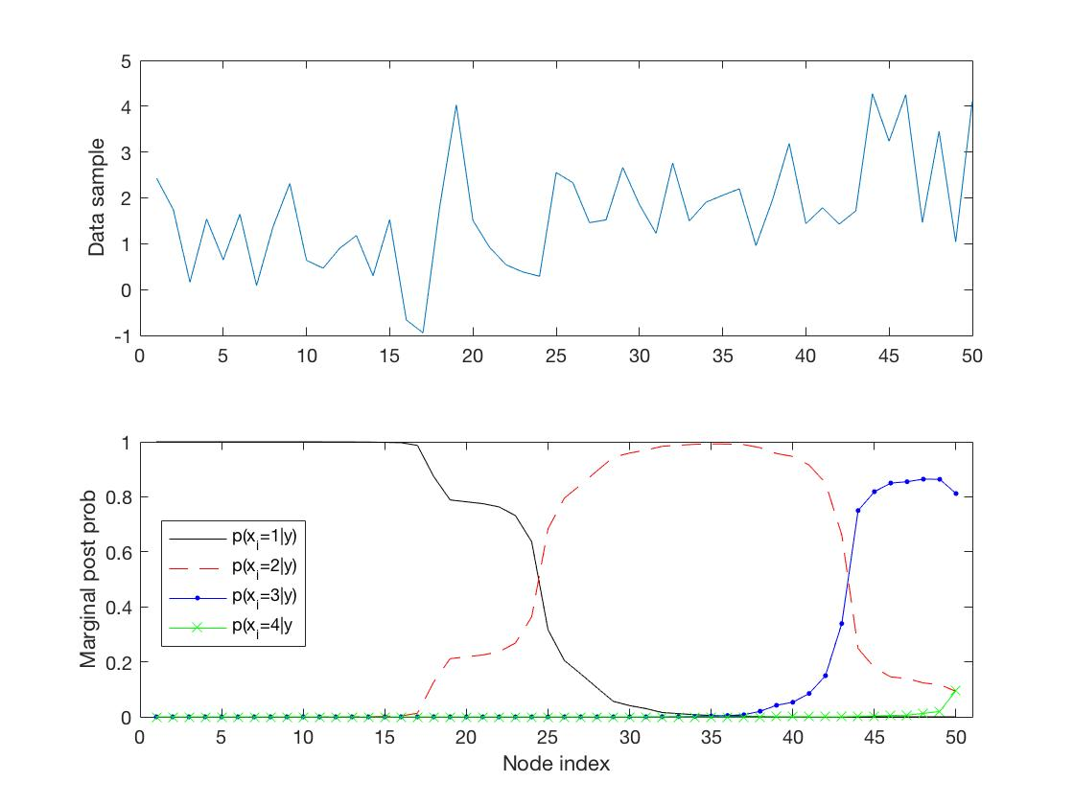
Results – one realization

Slide 56
Results – different tests
All sites | Only 10 first | Only 11-20 | Only 21-30 | Only 31-40 | Only 41-50
126 | 36 | 69 | 87 | 91 | 82
Only every second (5 measurements) gives VOI=83.
Partial tests can be very valuable! Especially if they are done in interesting subsets of the domain.

Slide 57
Plan for course
Time | Topic
Monday | Introduction and motivating examples
 | Elementary decision analysis and the value of information
Tuesday | Multivariate statistical modeling, dependence, graphs
 | Value of information analysis for dependent models
Wednesday | Spatial statistics, spatial design of experiments
 | Value of information analysis in spatial decision situations
Thursday | Examples of value of information analysis in Earth sciences
 | Computational aspects
Friday | Sequential decisions and sequential information gathering
 | Examples from mining and oceanography
Every day: Small exercise half-way, and computer project at the end.

Slide 58
Project 2 : Markovian risk of avalanche
Implement a Markov chain example for avalanche risk 1 or 2, with VOI analysis.
At every location one can remove risk by cost 10. If it is not removed, the repair cost depends on the unknown risk class:
Compute marginal probabilities for the following Markov chain with initial state probability and transition probability:
Condition on risk-class 1 or 2 (perfect information) at node 20. Compute conditional probabilities. Compare with marginal probabilities.
Compute the prior value. Compute the posterior value and VOI for different single locations perfect observations. What is the best place to survey?

Slide 59
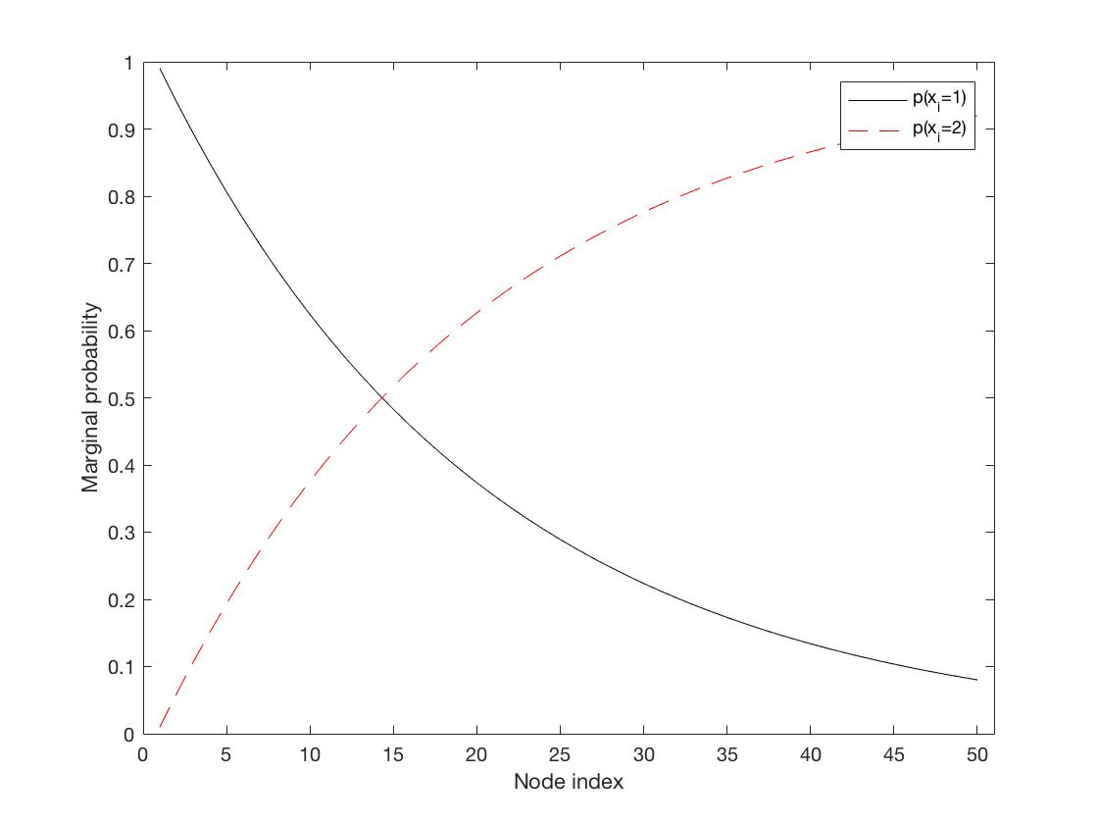
Results – marginals

Slide 60
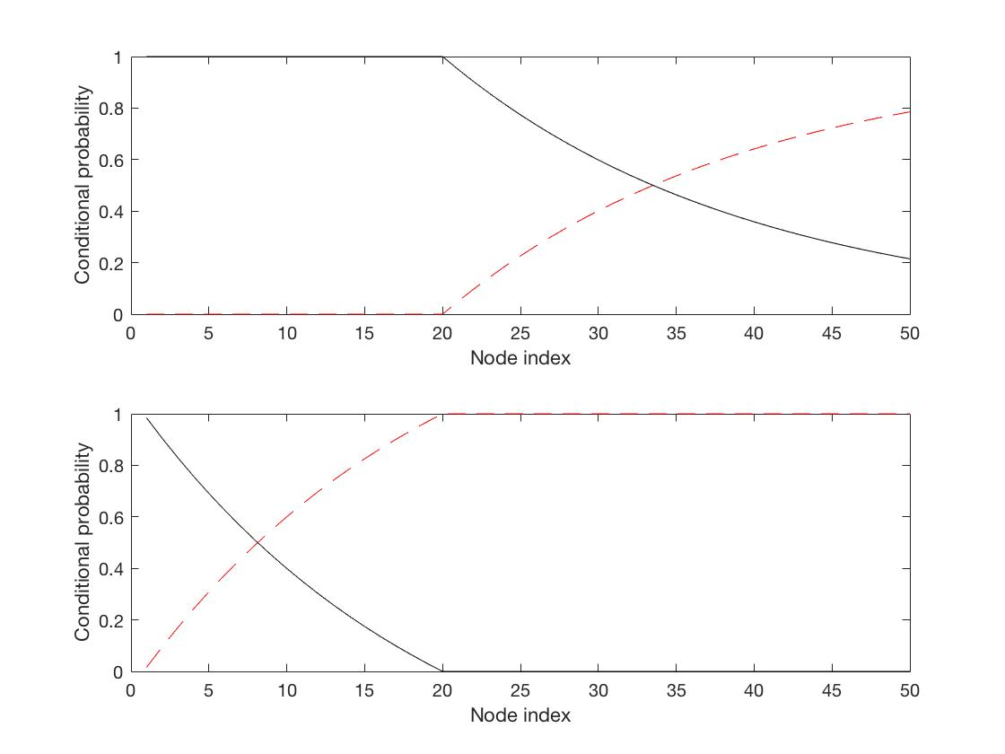
Results – conditionals (forward)

Slide 61
Results – conditionals (backward)

Slide 62
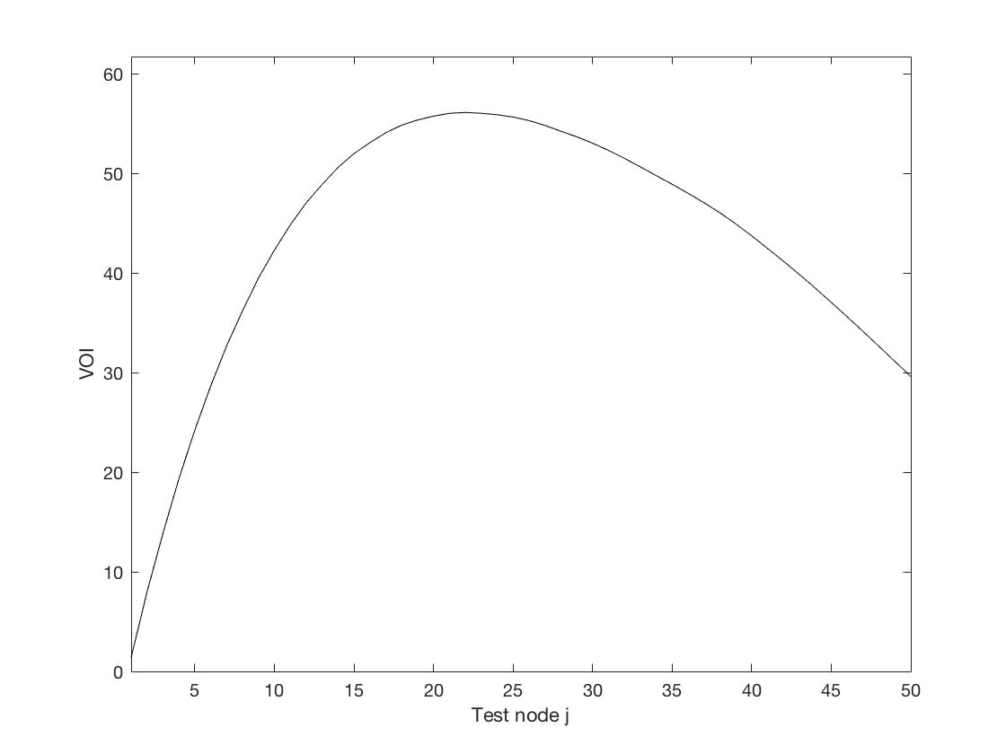
Results – VOI

